Slide 1

Enterprise Scale and Azure Landing Zone Engagement CSA Delivery Guide
Abe Kifle – Sr. CSA​
Arturo Quiroga - Sr. CSA​
James Pennington - CSA​
Molina Sharma – CSA​
Eric Leonard - CSA​
​
Microsoft Canada - GPS

Slide 2

Azure landing zone CSA Delivery Guide
The CSA Delivery Guide includes:
Field Execution Guidance
How to plan and execute an Azure landing zone workshop
Azure landing zone tools and resources
Azure landing zone design area slides to support workshop presentations and conversation with customer.
Notes:
Enterprise-scale is an architecture approach and reference implementation that enables effective construction and operationalization of landing zones on Azure, at scale and aligned with Azure Roadmap and Microsoft Cloud Adoption Framework for Azure.
In this design workshop we review each design guidelines and what decisions need to be documented for the of the Azure Enterprise-scale landing zone implementation.

Slide 3
Azure landing zone workshop: Audience
Microsoft
Customer Success
Customer Engineers
Cloud Solution Architects
Customer Field Roles
Partner/MCS/Fast Track
Technical Lead
Customer Leads *
Arch Lead/Chief Architect
Network (NetOps)
Identity and Access Management (IAM)
Systems (SysOps: OS, DB)
Operations and Management
Security (SecOps)
DevOps and Automation
Application Architecture
(*) Customer may bring additional SMEs where and when required.
Notes:
Before selecting a date for the design workshop confirm the right business decision makers and teams are involved to enable the cloud operating model for Enterprise-scale.

Slide 4
Azure landing zone: Workshop Objective
Review
Deep understanding of customer environment, workloads, and technical constraints
Success Criteria
Document and plan all technical requirements to build customers Azure environment are understood and captured.
First Production workload deployed
Design
Target platform architecture is designed that is aligned with Azure landing zone conceptual architecture and aligned with customer Azure environment requirements.
Success Criteria
Target platform architecture design agreed and documented.
Notes:
The workshop is a time of collaboration and team cooperation to build customer confidence in the cloud operating model that will accelerate production adoption.
Review- Customers have concerns about cloud architecture and want to know with confidence the Azure services they should implement that will meet business and technical requirements. A deep understanding of the customer environment and architectural motivations is required to reduce adoption friction. Ask questions to make sure we understand the customers motivations. It also important to ask questions that confirm what the customers level of knowledge is about Azure Architecture best practices and patterns.
While reviewing each design guideline confirm the architectural decisions made and document them while confirming they align with the Enterprise-scale principles. Any deviation from enterprise scale design principles or design guidelines recommendations should be documented and communicated so the customer understands the effects of the deviation.
Success criteria should focus on completing the implementation of Enterprise-scale landing zone with a production workload identified by the customer in the workshop. The customer maybe familiar with Azure and a full week for the workshop may not be required or you may not need to cover every topic in the example agenda provided. Meet the customer momentum and pull in extended team members who can go as deep as necessary in order to complete the landing zone design.

Slide 5


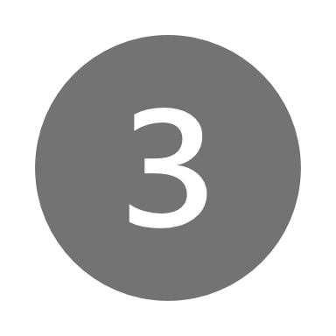
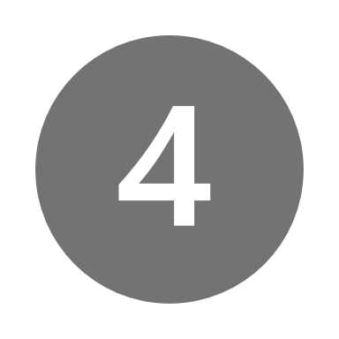

Azure landing zones
Example EXECUTION GUIDANCE
STEP
Engagement Targeting &
Customer Commitment
In-depth study with
Discovery workshop
Final Plan/Resourcing
Confirm Timing & Design
Take action & hands-on build architecture
Enhancement of Azure environment
OUTCOMES
PRIMARY
ROLE
Specialist
Cloud Solution Architect
Cloud Solution Architect
Cloud Solution Architect
Cloud Solution Architect
w/ SSP, ATS, CSAM, Partner (AMMP)
w/ CSA, ATS, CSAM, Partner (AMMP)
w/ CSAM, Partner (AMMP)
w/ CSAM, Partner (AMMP)
w/ CSAM, Partner (AMMP)
SUCCESS CRITERIA
Customer executive buy-in and sponsorship confirmed
Capture and understand all technical requirements
Customer agreement on architecture design
Customer understands and agrees to build and operate cloud platform at scale
Environment deployed and new opportunities identified
ACTIVITIES
and
RESOURCES
Mobilize internal team
Engage with customer
Deliver vision and scope for enterprise-scale landing zones project
Secure customer commitment and sponsorship
Review customer environment
In-depth study of customer DC architecture
Deliver Enterprise-scale Workshops with CSA Delivery Guide
Agree on architecture design
Coordinate customer working session to finalize design, review documented decision
Leverage automated deployment of GitHub as needed
Hands-on, Plan-to-build & Build design architecture
Identify key roles/functions and responsibilities
Build sample platform (non-prod, throw-away)
Develop plans
Confirm status & identify new opportunities
Validate implementation
Identify new migration opportunities
Overview of Azure landing zones using Cloud Adoption Framework Ready module
CSA Delivery Guide: Azure landing zone within CAF Ready
Review Requirements Azure landing zone Accelerator User Guide environment setup tutorial (GitHub)
Azure landing zones Accelerator
Azure landing zones reference implementation

Slide 6
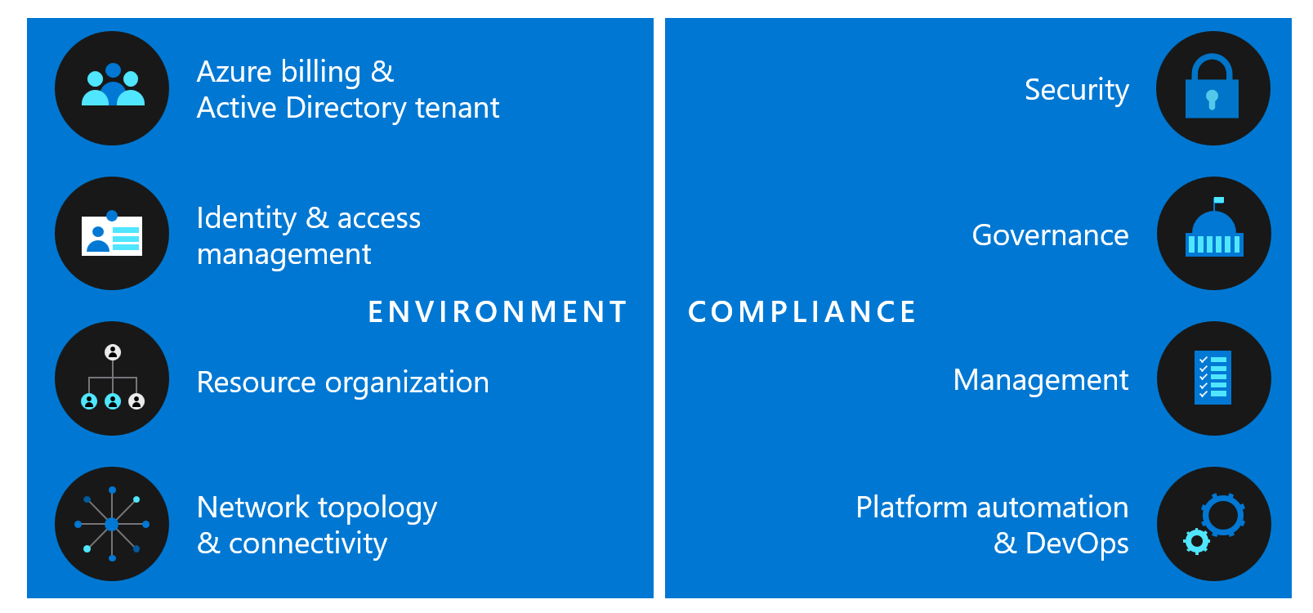
Azure Landing Zone Delivery
Be loyal to the design principles across the design areas
Capture decisions mutually agreed upon with customer in the Azure Landing Zone Checklist
Capture trade-offs; make customer aware of the implications
The next slides provides an example of how to review and make design decisions jointly with the customer, through the lenses of the Enterprise-scale critical design areas
Notes:
The design principles and critical design guidelines have been used with customers to implement success and the Enterprise-scale Architecture aligns to the Azure roadmaps. If a customer wants to deviate from the principles or critical design area explain our methodology and confirm they understand our positioning. In the end capture any trade offs or deviations a customer makes and document the implications.

Slide 7
Azure landing zone customer success engagement Tools & resources
Introduction | Plan | Workshop | Implement
 | Get familiar with Azure landing zone Accelerator with Interactive Guide | Azure landing zone Checklist | Azure landing zone accelerator

Slide 8
Azure Landing Zone: Workshop Example Agenda 1
 | Day 1 [Azure-> Landing Zone] | Day 2 [Networking & Connectivity] | Day 3 [Management and Security] | Day 4 [DevOps] | Day 5 - [Optional] [Show & Tell]
09:00 | Introductions - Goals and Objective, Identify first workload for production in Azure | [as-is] Networking and Connectivity Review | [as-is] Management and Monitoring | [as-is] Business Continuity and Disaster Recovery | Critical Design Path - Show and Validate 1. File->New->Landing Zone and Subscription democratisation 2. IAM and AAD PIM 3. Complaint VM 4. Management and Security at-scale
09:30 | [as-is] Subscription Organization and Application Portfolio
10:00 |  |  | Platform Management and Monitoring | HA/BCDR
10:30 |  | Global Azure Network Topology
11:00 |  |  | Application Management and Monitoring | [as-is] DevOps - Capability Review
11:30
12:00
12:30 | Lunch
13:00
13:30 | Enterprise-scale Design Principles and ALZ Design Areas | Connectivity to Azure - ER, NGF/WAF, Network, DNS Ingress/Egress, Segmentation | [as-is] Security and Compliance | What-must-be-true for the “Enterprise-scale” File -> New -> Region and File -> New -> “Landing Zone” | Critical Design Path - Show and Validate 6. Platform DevOps with Enterprise-Scale in-a-box
14:00
14:30 | Landing Zone Design EA, Identity and Access Management and Management Group and Subscription Organization |  | Encryption and Key Management
15:00
15:30 |  | Connectivity to Azure PaaS Services, Inbound and Outbound Internet Connectivity | Policy Driven Governance | "Monday Morning" Implementation - Accelerators/Blockers and Next Steps
16:00
16:30 | Platform - Operating Model |  | Service Enablement Framework
17:00
Notes:
This is an example agenda for an Azure landing zone workshop that covers all the design principles and design area topics to ensure successful landing zone design. This Agenda is also broken down into sub topics. Some customers may exhibit maturity in certain areas and may not need a session for each topic.

Slide 9
Azure Landing Zone: Workshop Example Agenda 2
 | Day 1 | Day 2
09:00 | Azure Billing and Active Directory Identity and Access Management | Management Governance
09:30
10:00
10:30
11:00
11:30
12:00
12:30 | Lunch
13:00
13:30 | Resource Organization Network Topology and Connectivity | Security Platform Automation and DevOps
14:00
14:30
15:00
15:30
16:00
16:30
17:00
In this example agenda for workshop where the customer would like to dedicate two days to review the Azure landing zone design areas.
Notes:
The example agenda for an Enterprise-scale workshop covers all the principles and critical design area topics to ensure successful landing zone design. Some customers may exhibit maturity in certain areas and may not need a session for each topic. Document the recommendations and the decisions the customer has already made so the complete vision for the Azure landing zone is captured in the design output.

Slide 10
Azure Landing Zone: Workshop Example Agenda 3
 | Day 1 | Day 2 | Day 3 | Day 4
09:00 | Azure Billing and Active Directory | Resource Organization | Management | Security
09:30
10:00 |  |  | Governance | HA/BCDR
10:30 | Identity and Access Management | Network Topology and Connectivity | Governance | Platform Automation and DevOps
11:00 |  |  | Application Management and Monitoring | Platform Automation and DevOps
11:30
12:00
In this third workshop agenda example the customers requirement is to meet in smaller sessions over 4 days.
Notes:
The example agenda for an Enterprise-scale workshop covers all the principles and critical design area topics to ensure successful landing zone design. Some customers may exhibit maturity in certain areas and may not need a session for each topic. Document the recommendations and the decisions the customer has already made so the complete vision for the Azure landing zone is captured in the design output.

Slide 11
Key Technical Teams for Workshop
Roles | Function in the platform team
Systems Ops | Make AppOps and DevOps teams effective through a federated delegation model that is centrally governed e.g., monitoring, patching and backups and take corrective action centrally when necessary Manage platform wide monitoring and alerts; alignment with Azure scheduled maintenance events Setup and manage VM/OS standards
Security Ops | Define an Azure Platform baseline to ensure compliance of security requirements and controls are met Create Policy Compliance and Security Dashboards for organizational and resource centric views Define break glass/emergency process to grant and revoke access Management of platform keys and secrets Security Policy remediation and compliance initiatives
Automation | Develop and maintain DevOps pipeline and standards Develop and maintain business processes and integration points (such as CMDB etc.) Support the team’s use of the DevOps pipeline and standards Support the team to develop SME specific artefacts
Network Ops | Network design, deployment, configuration and management Manage inbound, outbound, and east-west networking flows Manage routing and network segregation within Azure virtual networks and hybrid connectivity Network troubleshooting Azure network monitoring and auditing Performance metrics and counters Network forensics
Identity and Access Management | Establish organizational relationship between Azure Active Directory and Azure Subscriptions in the Enterprise Portal Mange IAM entitlements and Role definitions for Management Groups and Subscriptions Manage AAD Applications, Service Principles, and AAD Application Proxies; registration of Service Principles and Applications with configured delegation Windows Server Active Directory administration Define and manage JML for AD and AAD users and groups for Azure IAM Manage MFA sign-in for the Azure control plane and data plane access
Management | Manage Management Groups and Subscription lifecycles Resource provider registration Manage Azure Policy Definitions and Assignments at Management group level and Subscription levels Create Dashboard and Management views for Application centric and Platform Centric management, monitoring, and policy compliance Enable auxiliary functions on the Azure platform, such as Cost Management and Azure Advisor
Enablement | Support the onboarding of application teams to the platform Develop reusable artefacts to accelerate application team onboarding such as templates Collect, compile, and manage feedback to improve the platform
Data Management and Analytics Roles

Slide 12
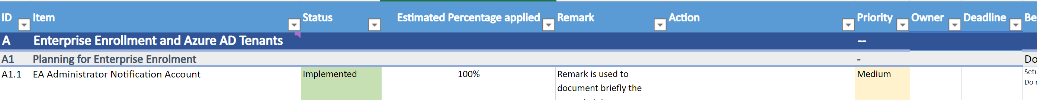
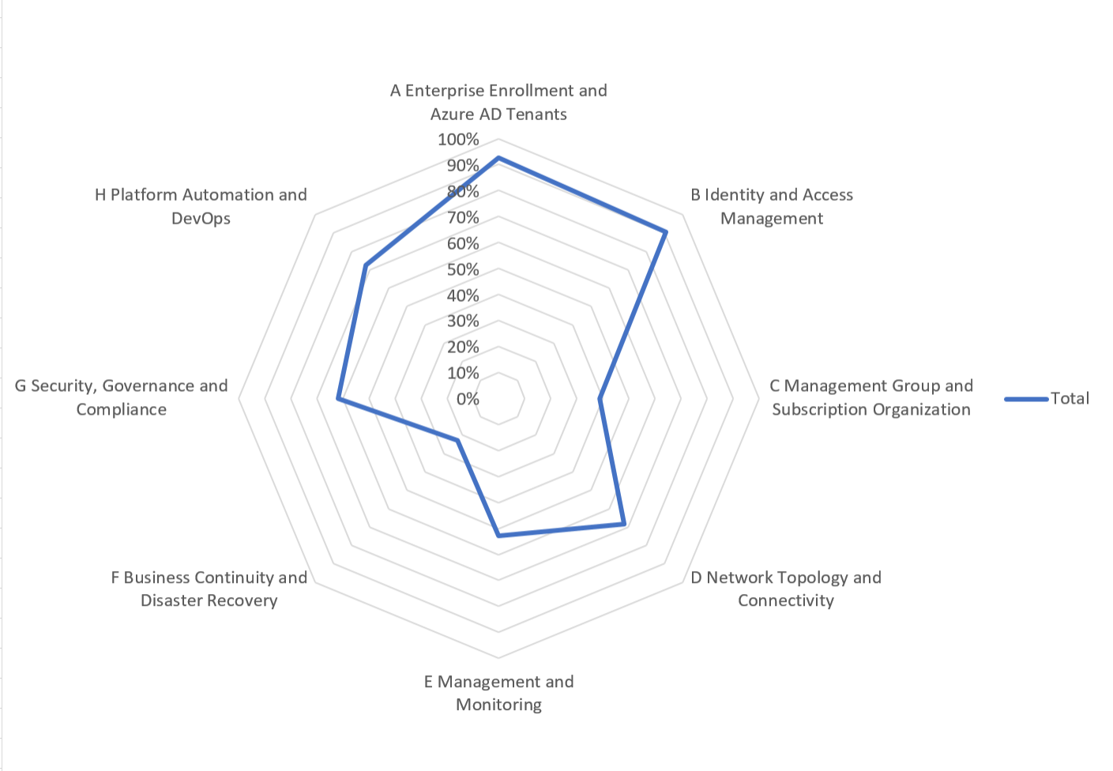
Capturing inputs and Azure Landing Zone checklist
1- Review the detailed recommendations in the checklist:
Define the priority, status, owner and deadline for each recommendation of the different critical design areas
2- The overall score will give you a holistic overview of the ESLZ critical design areas progress, depending on the weight/importance of each recommendation
3- The recommendations overview highlights the most important best practices for each critical design area, you can review/discuss them with the customer

Slide 13
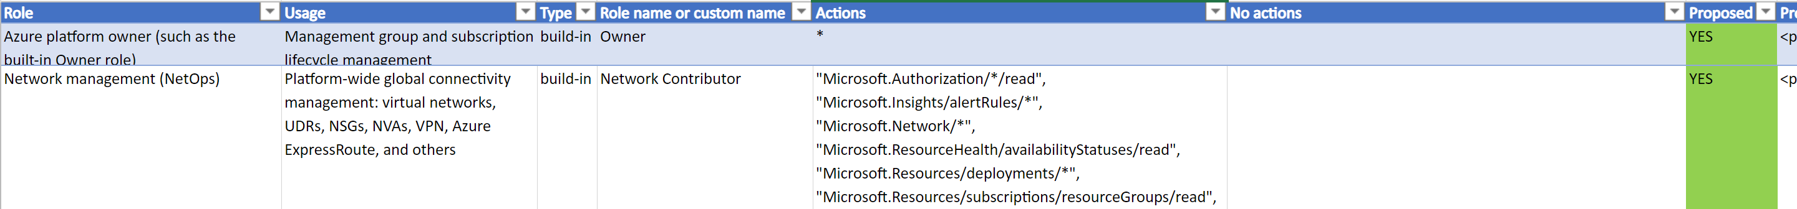
Capturing inputs and Azure Landing Zone checklist
4- The Role Sheet will help you document the different roles with their respective scopes, in use/planned to be used at the customer’s environment
This should be discussed in priority with the customer, and reviewed regularly
5- The policy sheet helps to document the decisions around Azure policies to be used
This should be discussed in priority with the customer, and reviewed regularly
6- Use the tags sheet to track the decisions of Azure tags usage as part of your ESLZ discussions with the customer

Slide 14
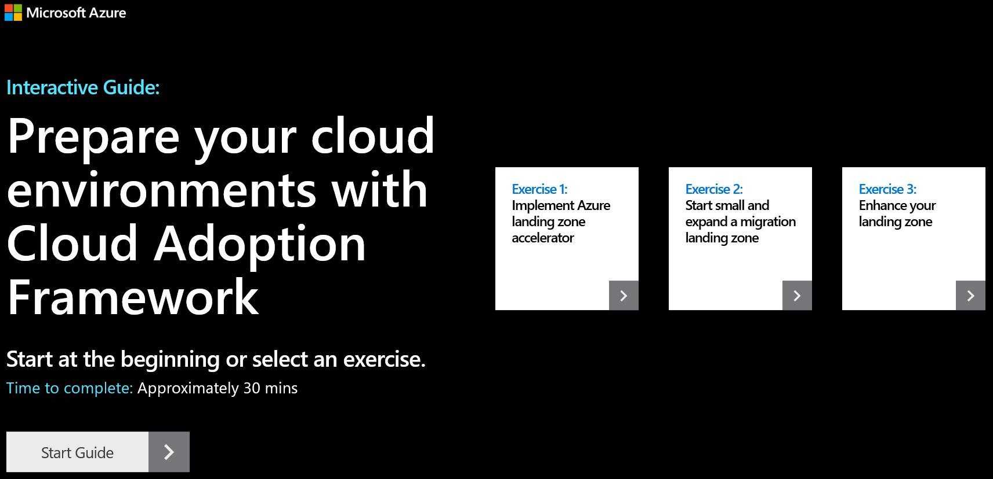
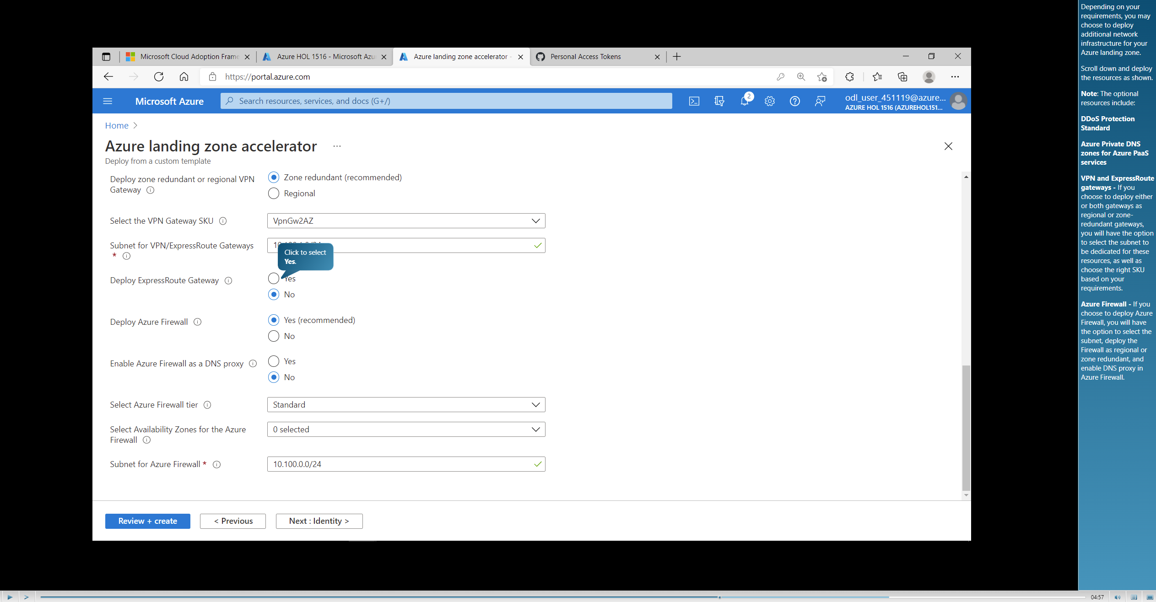
Azure landing zone Interactive Guide: Azure Landing Zone interactive Guide
3 Exercises to complete Interactive Guide
-Implement Azure landing zone accelerator
-Start small and expand a migration landing zone
-Enhance your landing zone

Slide 15
Reminder
The impact of decisions made within these critical areas will reverberate across the Azure landing zone architecture and influence other decisions.
Readers are strongly advised to familiarize themselves with these eight areas, to better understand the consequences of encompassed decisions, which may later produce trade-offs within related areas.
Notes:
Stick to your guns on representing the principles and critical design area recommendations.

Slide 16
Azure landing zone conceptual architecture
The Azure landing zone conceptual architecture represents the strategic design path and target technical state for your Azure environment.
It will continue to evolve in lockstep with the Azure platform and is ultimately defined by design decisions aligned with defined principles to safeguard your Azure journey.
Notes:
Enterprise-scale is an architecture approach and reference implementation that enables effective construction and operationalization of landing zones on Azure, at scale and aligned with Azure Roadmap and Microsoft Cloud Adoption Framework for Azure.
In this design workshop we review each design guidelines and what decisions need to be documented for the of the Azure Enterprise-scale landing zone implementation.

Slide 17

Azure landing zones Design areas
Azure billing & Active Directory tenant
Security
Identity & access management
Governance
ENVIRONMENT
COMPLIANCE
Resource organization
Management
Network topology & connectivity
Platform automation & DevOps
Notes:
There are different Azure landing zone implementation options and each of them provide a different deployment approach. Before choosing an implementation option, let’s talk about the design areas for Azure landing zones.

Slide 18
8 Critical Design Areas
Azure Billing and Active Directory
Identity and Access Management
Resource Organization
Network Topology and Connectivity
Management
Governance
Security
Platform Automation and DevOps

Slide 19
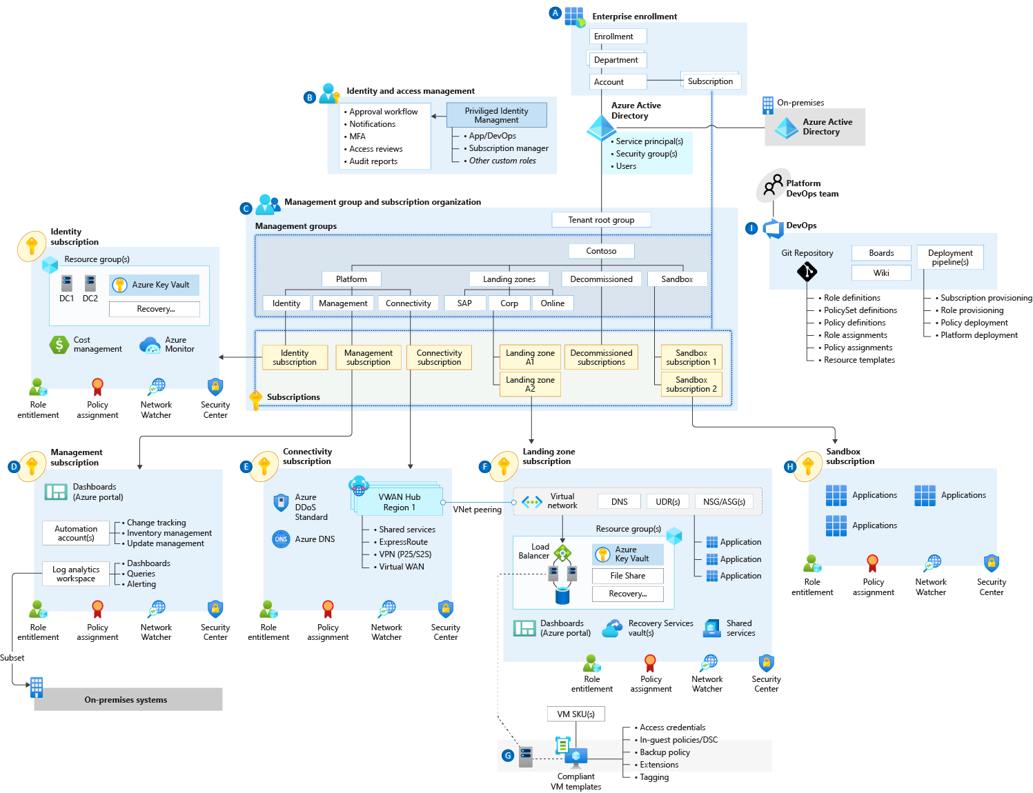

Define Azure AD Tenants
Azure Billing and Active Directory
Enterprise enrolment roles links users with their functional role and consists of
Enterprise Administrator
Department Administrator
Account Owner
Service Administrator
Notification Contact
A1
Notes:
If they don’t have separate identity then from the platform perspective – it is just production in test.
Examples:
Department isn’t Org chart. Create Departments only if business domains have independent IT capabilities and map customer business divisions.
If multiple AAD tenants are used, ensure the Account owner is associated with the same tenant as where subscriptions from the EA account are provisioned. Separate Dev/Test/Prod environments at an EA account level to support holistic isolation.
Do not move or rename an EA Account in AD/Azure AD
Do not ignore notification emails sent to the notification account email address. Microsoft sends important EA wide communications to this account. Setup the notification account email address to ensure notifications are sent to an appropriate group mailbox.
Assign a budget for each account and establish an alert associated with the budget.
Restrict and minimise the number of Account owners within the Enrolment to avoid the proliferation of admin access to Subscriptions and associated Azure resources

Slide 20

Identity & Access Management
Privileged Identity Management
Multi-Factor Authentication
Conditional Access
Role Based Access Control
Auditing and Logging
Managed Identities for Azure resources
Active Directory
Azure AD-DS
Planning for Authentication Inside the Landing Zone
B1
Notes:
Identity and Access Management in Enterprise-scale addresses Azure control plane, data plane, and application layer requirements.
Planning for Identity and Access Management begins with the Azure platform and Azure Active Directory. Many consider identity to be the primary perimeter for security. This is a shift from the traditional focus on network security. Network perimeters keep getting more porous, and that perimeter defense can’t be as effective as it was before the explosion of BYOD devices and cloud applications. Enterprise-scale recommendations focus on defining least privileged Role Based Access Control roles aligned to the customer’s operating model and leveraging Azure capabilities to apply additional layers of access control.
Use Azure AD Privileged Identity Management to establish zero standing access and to enable approval workflows for just-in-time control plane access to azure resources. Granting entitlements through PIM, rather than direct resource access, helps to protect against legacy access rights that often result from changing roles and responsibilities within an organization.
Use Azure AD PIM access reviews to periodically validate resource entitlements. Regularly scheduled reviews of access rights and entitlement use is a regulatory requirement for many customers. Determining which users had access to what resources for a given time period is much easier with PIM compared to querying AAD audit logs.
Customer RBAC roles should be used to define access rights across the Azure estate. Key roles within an organization will typically include Platform Owners, NetOps, SecOps, AppOps, and DevOps. Well defined and scoped RBAC role definitions enable subscription democratization through the segregation of duties required by an organization’s operating model.
Integrate Azure AD logs with the platform-central Azure Monitor Log Analytics workspace for audit reports and alert notifications.
Use Azure AD Managed Identities (MI) for Azure resources, avoiding username and password-based authentication. Managed Identities provide the simples and most secure method for enabling service to service communication. Managed Identities eliminate the need for credentials in your code, they rotate credentials automatically, and can be used to authenticate to any service that supports Azure AD authentication.
Multi-Factor Authentication should be enforced on all privileged accounts. If you only use a password to authenticate a user, it leaves an insecure vector for attack. If the password is weak or has been exposed elsewhere, is it really the user signing in with the username and password, or is it an attacker? When you require a second form of authentication, security is increased as this additional factor isn't something that's easy for an attacker to obtain or duplicate.
Conditional Access policies should be enforced on all privileged accounts. Azure Active Directory (Azure AD) Conditional Access (CA) analyses signals such as user, device, and location to automate decisions and enforce organizational access policies for resource. You can use CA policies to apply access controls like Multi-Factor Authentication (MFA). CA policies allow you to prompt users for MFA when needed for security and stay out of users’ way when not needed.
Planning for Authentication Inside the Landing Zone is concerned with workload access and dependencies on on-premises systems. A critical design decision enterprise organization must make when adopting Azure is whether to extend and existing on-premises identity domain into Azure or create a brand new one. Requirements for authentication inside the "Landing Zone" should therefore be thoroughly assessed and incorporated into plans to deploy AD, Azure AD-DS or both.
Examples:
Use AAD RBAC to manage data plane access to resources where possible (e.g. Key Vault, Storage Account, Azure SQL DB). Use Managed Identities instead of Service Principles for authentication to Azure services.
Evaluate the compatibility of workloads for AD and AAD-DS. Do not assume existing workloads are agnostic of AD and AAD-DS authentication, as there are differences between both approaches.
Deploy AAD-DS within the primary region as this service can be projected into only one subscription. Use Virtual Network Peering to support its usage as an authentication service.
Use Just-In-Time access for both VM access and Azure control plane administration.
Knowledge Check
Where should Azure Control Plane Groups live?
a.) On-Premise AD – The group will not be able to
b.) On-premise AD synced to Azure AD
c.) Azure AD only – You are managing your control plane on Azure only, so having this group on premise creates overhead with no functional benefit. Always create groups in Azure AD if they don’t manage anything on premise.
How should resource to resource authentication occur?
a.) By using Managed Services Identities - The feature provides Azure services with an automatically managed identity in Azure AD. You can use the identity to authenticate to any service that supports Azure AD authentication, including Key Vault, without any credentials in your code.
b.) By using Password Based Authentication – this is a static method and not best practice as securely storing these credentials creates management overhead
c.) Use Azure Key Vault – key vault provides storage to your keys and secrets but it’s not responsible for initiating authentication

Slide 21
Identity & Access Management
Azure Active directory tenant (AAD) is an instance of Azure AD. Within the AAD there are users who may belong to groups. In Addition Apps use service principal & managed identity.
Azure AD can be associated with more than one subscription and its primary function is authenticating users and services.
Azure role-based access control (Azure RBAC) is a system that provides fine-grained access management of Azure resources.
Using Azure RBAC, you can segregate duties within your team and grant only the amount of access to users that they need to perform their jobs
Planning for Authentication Inside the Landing Zone
B2
Notes:
Use AAD RBAC to manage data plane access to resources where possible (e.g. Key Vault, Storage Account, Azure SQL DB). Use Manged Identities instead of Service Principles for authentication to Azure services.
Evaluate the compatibility of workloads for AD and AAD-DS. Do not assume existing workloads are agnostic of AD and AAD-DS authentication, as there are differences between both approaches.
Deploy AAD-DS within the primary region as this service can be projected into only one subscription. Use Virtual Network Peering to support its usage as an authentication service.
Use Just-In-Time access for both VM access and Azure control plane administration.

Slide 22
Custom RBAC Roles
Role | Usage | Actions: | No Actions:
Azure Platform Owner | Management Group and Subscription lifecycle management | *
Network Management (NetOps) | Platform wide Global Connectivity management; VNets, UDRs, NSGs, NVAs, VPN, ER etc. | */read, Microsoft.Authorization/*/write, Microsoft.Network/vpnGateways/*, Microsoft.Network/expressRouteCircuits/*, Microsoft.Network/routeTables/write, Microsoft.Network/vpnsites/*
Security Operations (SecOps) | Security Administrator role with a horizontal view across the entire Azure estate and the KV Purge Policy | */read, */register/action, Microsoft.KeyVault/locations/deletedVaults/purge/action, Microsoft.Insights/alertRules/*, Microsoft.Authorization/policyDefinitions/*, Microsoft.Authorization/policyassignments/*, Microsoft.Authorization/policysetdefinitions/*, Microsoft.PolicyInsights/*,Microsoft.Security/*
Subscription Owner | Delegated Role for Subscription Owner derived from subscription Owner role | * | Microsoft.Authorization/*/write, Microsoft.Network/vpnGateways/*, Microsoft.Network/expressRouteCircuits/*, Microsoft.Network/routeTables/write, Microsoft.Network/vpnsites/*
Application Owners DevOps/AppOps | Contributor role granted for application/operations team at resource group level |  | Microsoft.Network/publicIPAddresses/write, Microsoft.Network/virtualNetworks/write, Microsoft.KeyVault/locations/deletedVaults/purge/action
Notes:
There should be a handful/limited amount of custom roles for specific functions within an organization. Having custom roles in excess is an anti-cloud pattern. Below are some example roles that define the
Scope of responsibility for the corresponding teams. This is not a definitive list and rather a guideline for discussing with the customer how azure will be administered day to day.
Azure Platform Owner
- limited to teams who are managing both the resource group and subscription
Network Management
broad role granting access to all network services
Allocated to team responsible for network operations
Security Operations (SecOps)
- Responsible for securing administration and compliance
Subscription Owner
This role iterates on the built in role by giving the ability to restrict the subscription owner
E.G. – An application lead who is a subscription owner
You can also restrict them from Microsoft Authorization
E.G Prevent users with this role from modifying policies or denying access to route tables which would could pose a security risk)
Application Owners (DevOps/SecOps)
Access granted at the resource group level for provisioning and managing the lifecycle of the resources created.
Should identify the maturity of the customer. Whether the organization has a DevOps or AppOps Team
DevOps – owned by application owner
AppOps – owned by a designated platform team, sometimes outsource (e.g MSP)
Knowledge Check:
1.) It’s best practice to create as many custom roles as possible
a.) True
b.) False - Custom roles should only be assigned as needed for specific use cases for your organization as built-in policies already cover most scenarios
1.) It’s best practice Subscription owners should have contributor rights to Microsoft Authorization rights
a.) True
b.)False - Subscription owners should have contributor rights to resources within the subscription that are not centrally shared. Granting Microsoft Authorization which is centrally managed will allow the owner modify permissions that limit their scope, remove separation, and could pose security risks.

Slide 23

Resource Organization
Azure Management Groups provide a way to efficiently manage access, policies, and compliance across an enterprise through a hierarchy made up of management groups and subscriptions.
Consider the following design elements:
Use Management Group structure within an AAD tenant to support org mapping
Must be appropriately considered when planning Azure adoption at-scale
Define a Management Group Hierarchy
C1
Notes:
Define a management group hierarchy
Management group structures within an Azure Active Directory (Azure AD) tenant support organizational mapping and must be considered thoroughly when an organization plans Azure adoption at scale.
Design considerations:
Management groups can be used to aggregate policy and initiative assignments via Azure Policy.
A management group tree can support up to six levels of depth. This limit doesn't include the root or subscription level.
Design recommendations:
Keep the management group hierarchy reasonably flat with no more than three to four levels, ideally. This reduces management overhead and complexity.
Avoid duplicating your organizational structure into a deeply nested management group hierarchy. Management groups should be used for policy assignment versus billing purposes. This necessitates using management groups for their intended purpose in enterprise-scale architecture, which is providing Azure policies for workloads that require the same type of security and compliance under the same management group level.
Create management groups under your root-level management group to represent the types of workloads (archetype) that you'll host and ones based on their security, compliance, connectivity, and feature needs. This allows you to have a set of Azure policies applied at the management group level for all workloads that require the same security, compliance, connectivity, and feature settings.
Use resource tags, which can be enforced or appended through Azure Policy, to query and horizontally navigate across the management group hierarchy. This facilitates grouping resources for search needs without having to use a complex management group hierarchy.
Create a top-level sandbox management group to allow users to immediately experiment with Azure. This allows users to experiment with resources that might not yet be allowed in production environments and provides isolation from your development, test, and production environments.
Use a dedicated service principal name (SPN) to execute management group management operations, subscription management operations, and role assignment. This reduces the number of users who have elevated rights, following least-privilege guidelines.
Assign the User Access Administrator Azure RBAC role at the root management group scope (/) to grant the SPN mentioned above access at the root level. After the SPN is granted permissions, the User Access Administrator role can be safely removed. This ensures only the SPN is part of the User Access Administrator role.
Assign Contributor permission to the SPN mentioned above at the root management group scope (/), which allows tenant-level operations. This ensures that the SPN can be used to deploy and manage resources to any subscription within your organization.
Create a Platform management group under the root management group to support common platform policy and role-based access control (RBAC) assignment. This ensures that different policies can be applied to the subscriptions used for your Azure foundation, and that the billing for common resources is centralized in one set of foundational subscriptions.
Limit the number of Azure Policy assignments made at the root management group scope (/). This minimizes debugging inherited policies in lower-level management groups.
Do not create any subscriptions under the root management group. This ensures that subscriptions don't only inherit the small set of Azure policies assigned at the root-level management group, which don't represent a full set necessary for a workload.

Slide 24
Resource Organization
Define Hierarchy, Quota & Capacity, and Manage Cost
Subscription Organization and Governance
Use Management Group structure, within an AAD tenant, to support org mapping
Must be appropriately considered when planning Azure adoption at-scale
Configure Subscription Quota and Capacity
Platform limits and quotas within the Azure platform for services
Availability of required SKUs in chosen Azure regions
Subscription quotas are not capacity guarantees and are per region
Establish Cost Management
Potential need for chargeback models where shared PaaS services are concerned, such as ASE which may need to be shared to achieve higher density
Shutdown schedule for non-prod workloads to optimise costs
C2
Notes:
Main talking Points
Subscription Organization and Governance
Use Management Group structure within an AAD tenant to support org mapping
Must be appropriately considered when planning Azure adoption at-scale
Configure Subscription Quota and Capacity
Platform limits and quotas within the Azure platform for services
Availability of required SKUs in chosen Azure regions
Subscription quotas are not capacity guarantees and are per region
Establish Cost Management
Potential need for chargeback models where shared PaaS services are concerned, such as ASE which may need to be shared to achieve higher density
Shutdown schedule for non-prod workloads to optimise costs
Further Talking Point
Define Management Group Hierarchy Within an Azure AD tenant, Management Group structures help to support organizational mapping and must therefore be appropriately considered when planning Azure adoption at-scale.
Management groups can be used to aggregate Policy and Initiative assignments.
A management group tree can support up to six levels of depth. This limit doesn't include the Root level or the subscription level.
Subscription Organization and Governance Subscriptions are a unit of management, billing, and scale within Azure
Subscriptions serve as a boundary for the assignment of Azure policies.
Subscriptions serve as a scale unit so that component workloads can scale within the platform subscription limits.
Subscriptions provide a management boundary for governance and isolation, allowing for a clear separation of concerns.
Subscription Quotas and Capacity It is essential to ensure that sufficient capacity and SKUs are available. Every Azure region contains a finite set of resources at any given time.
Limits and quotas within the Azure platform for each service your workloads require.
Availability of required SKUs within chosen Azure regions.
Subscription quotas are not capacity guarantees and are applied on a per region basis.
Cost Management Cost transparency across a technical estate is a critical management challenge faced by every large enterprise organization
Using a shutdown schedule for non-production workloads to optimize costs
Using Azure Advisor to check cost optimization recommendations.
Potential need for chargeback models where shared PaaS services are concerned, such as ASE and AKS which may need to be shared to achieve higher density

Slide 25
Management Group & Subscription Organization
Subscriptions are a unit of management, billing, and scale within Azure, and they play a critical role when designing for large-scale Azure adoption.
Consider the following design elements:
Subscriptions serve as boundaries for assigning Azure policies
Subscriptions serve as a scale unit so that component workloads can scale within the platform subscription limits
Subscriptions provide a management boundary for governance and isolation, creating a clear separation of concerns
Subscription Organization and Governance
C2.3
Notes:
Subscription organization and governance
Subscriptions are a unit of management, billing, and scale within Azure, and they play a critical role when designing for large-scale Azure adoption. This section helps capture customer subscription requirements and design target subscriptions based on critical factors such as environment type, ownership and governance model, organizational structure, and application portfolios.
Design considerations:
Subscriptions serve as boundaries for assigning Azure policies. For example, secure workloads such as payment card industry (PCI) workloads typically require additional policies to achieve compliance. Instead of using a management group to group workloads requiring PCI compliance, you can achieve the same isolation with a subscription. This ensures that you don't have too many management groups with a small number of subscriptions.
Subscriptions serve as a scale unit so that component workloads can scale within the platform subscription limits. Make sure to consider subscription resource limits during your workload design sessions.
Subscriptions provide a management boundary for governance and isolation, creating a clear separation of concerns.
Design recommendations:
Treat subscriptions as a democratized unit of management aligned with business needs and priorities.
Make subscription owners aware of their roles and responsibilities:
Perform an access review in Azure AD Privileged Identity Management quarterly or twice a year to ensure that privileges don't proliferate as users move within the customer organization.
Take full ownership of budget spending and resource utilization.
Ensure policy compliance and remediate when necessary.
Use the following principles when identifying requirements for new subscriptions:
Scale limits: Subscriptions serve as a scale unit for component workloads to scale within platform subscription limits. For example, large specialized workloads such as high-performance computing, IoT, and SAP are all better suited to use separate subscriptions to avoid limits (such as a limit of 50 Azure Data Factory integrations).
Management boundary: Subscriptions provide a management boundary for governance and isolation, allowing for a clear separation of concerns. For example, different environments such as development, test, and production are often isolated from a management perspective.
Policy boundary: Subscriptions serve as a boundary for the assignment of Azure policies. For example, secure workloads such as PCI typically require additional policies to achieve compliance, and this additional overhead doesn't need to be considered holistically if a separate subscription is used. Similarly, development environments may have more relaxed policy requirements relative to production environments.
Target network topology: Virtual networks can't be shared across subscriptions, but they can connect with different technologies such as virtual network peering or ExpressRoute. Therefore, it's important to consider which workloads must communicate with each other when deciding if a new subscription is required.
Group subscriptions together under management groups aligned within the management group structure and policy requirements at scale. This ensures that subscriptions with the same set of policies and RBAC assignments can inherit them from a management group, avoiding duplicate assignments.
Establish a dedicated management subscription in the Platform management group to support global management capabilities such as Azure Monitor Log Analytics workspaces and Azure Automation runbooks.
Establish a dedicated identity subscription in the Platform management group to host Windows Server Active Directory domain controllers, when necessary.
Establish a dedicated connectivity subscription in the Platform management group to host an Azure Virtual WAN hub, private DNS, ExpressRoute circuit, and other networking resources. This ensures that all foundation network resources are billed together and isolated from other workloads.
Avoid a rigid subscription model, opting instead for a set of flexible criteria to group subscriptions across the organization. This ensures that as your organization's structure and workload composition changes, you're able to create new subscription groups instead of using a fixed set of existing subscriptions. One size doesn't fit all for subscriptions; what works for one business unit may not work for another. Some apps may coexist within the same landing zone subscription while others may require their own subscription.

Slide 26
Management Group & Subscription Organization
Each Azure region contains a finite number of resources. When considering an enterprise-scale Azure adoption involving large resource quantities, ensure that sufficient capacity and SKUs are available, and the attained capacity can be understood and monitored.
Consider the following design elements:
Platform limits and quotas within the Azure platform for services
Availability of required SKUs in chosen Azure regions
Subscription quotas are not capacity guarantees and are per region
Subscription Quotas and Capacity
C3.1
Notes:
Configure subscription quota and capacity
Each Azure region contains a finite number of resources. When considering an enterprise-scale Azure adoption involving large resource quantities, ensure that sufficient capacity and SKUs are available, and the attained capacity can be understood and monitored.
Design considerations:
Consider limits and quotas within the Azure platform for each service that your workloads require.
Consider the availability of required SKUs within chosen Azure regions. For example, new features might be available only in certain regions. The availability of certain SKUs for given resources such as VMs may be different from one region to another.
Consider that subscription quotas aren't capacity guarantees and are applied on a per-region basis.
Design recommendations:
Use subscriptions as scale units, and scale out resources and subscriptions as required. This ensures that your workload can use the required resources for scaling out, when needed, without hitting subscription limits in the Azure platform.
Use reserved instances to prioritize reserved capacity in required regions. This ensures that your workload will have the required capacity even when there's a high demand for that resource in a specific region.
Establish a dashboard with custom views to monitor utilized capacity levels. Set up alerts if capacity utilization is reaching critical levels (for example, 90 percent CPU utilization).
Raise support requests for quota increase as a part of subscription provisioning (for example, total available VM cores within a subscription). This ensures your quota limits are set before your workloads require going over the default limits.
Ensure required services and features are available within the chosen deployment regions.

Slide 27
Management Group & Subscription Organization
Cost transparency across a technical estate is a critical management challenge faced by every large enterprise organization. This section will explore key aspects associated with how cost transparency can be achieved across large Azure environments.
Consider the following design elements:
Potential need for chargeback models where shared PaaS services are concerned, such as ASE which may need to be shared to achieve higher density
Shutdown schedule for non-prod workloads to optimize costs
Cost Management
C4
Notes:
Establish cost management
Cost transparency across a technical estate is a critical management challenge faced by every large enterprise organization. This section will explore key aspects associated with how cost transparency can be achieved across large Azure environments.
Design considerations:
Potential need for chargeback models where shared platform as a service (PaaS) resources are concerned, such as Azure App Service Environment and Azure Kubernetes Service, which may need to be shared to achieve higher density.
Use a shutdown schedule for nonproduction workloads to optimize costs.
Use Azure Advisor to check cost optimization recommendations.
Design recommendations:
Use Azure Cost Management for cost aggregation and make it available to application owners.
Use Azure resource tags for cost categorization and resource grouping. This allows you to have a chargeback mechanism for workloads that share a subscription or for a given workload that spans across multiple subscriptions.
.

Slide 28
8 Critical Design Areas
Azure Billing and Active Directory
Identity and Access Management
Resource Organization
Network Topology and Connectivity
Management
Governance
Security
Platform Automation and DevOps

Slide 29
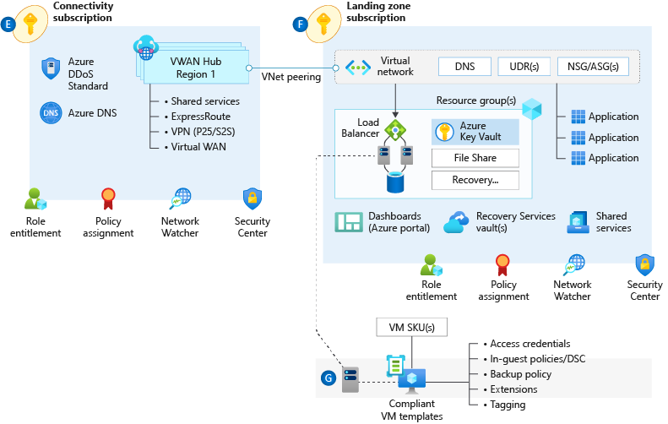

Network Topology & Connectivity
Planning for IP Addressing
Configure DNS
Define an Azure Networking Topology
Connectivity to Azure
Connectivity to Azure PaaS services
Plan for inbound and outbound internet connectivity
Plan for app delivery
Plan for landing zone network segmentation
Plan for traffic inspection
D
Notes:
Network topology and connectivity within Enterprise-scale addresses the need for establishing the end-to-end connectivity for all landing zones in the enterprise Azure estate. The subject is both broad and complex and will likely consume a significant portion of the overall design effort. It is critical for successful delivery to ensure that you have a thorough understanding of all design areas and Enterprise-scale recommendations, common alternative solutions, and the impact of deviating from the recommendations.
DNS Configuration within Enterprise-scale will be primarily influenced by the cross-premises name resolution requirements of landing zone workloads. For environments where name resolution in Azure is all that is required, native Azure DNS services should suffice. For environments where name resolution across Azure and on-premises is required, Azure VMs integrated with existing DNS infrastructure will be required. Integration with Private Link and services with special DNS requirements, such as OpenShift, must also be factored into the design.
Tip – A common scenario here is customer extends their DNS infra to Azure (Infoblox, AD, etc) but also uses the azure DNS resolver 168.* address as a forwarder for those in-azure DNS servers to assure private link resolution.
Azure Networking Topology
Azure Virtual WAN An Azure networking topology based-on Azure Virtual WAN is the preferred Enterprise Scale approach for large scale multi-region deployments where the customer needs to interconnect all their global locations on both Azure and on-premises. Azure Virtual WAN provides multiple advantages over traditional Azure networking, including:
Azure Virtual WAN is a Microsoft-managed solution, where end-to-end global transit connectivity is provided out-of-the-box. Virtual WAN Hubs eliminate the need for customers to manually setup the network connectivity. As an example, customer does not require to setup UDRs or NVAs to enable global transit connectivity.
Azure Virtual WAN greatly simplifies end-to-end network connectivity in Azure and cross-premises by creating a hub and spoke network architecture that spans multiple Azure regions and on-premises locations (any-to-any connectivity) out-of-the-box.
Azure Virtual WAN increases the limit of up to 200 prefixes advertised from Azure to on-premises via ExpressRoute Private Peering to 10,000 prefixes per single Virtual WAN Hub. The limit of 10,000 prefixes also includes VPN (S2S and P2S VPN).
Traditional Azure Networking can also be used to build a secure network foundation aligned to the Enterprise Scale design principles. A traditional Azure networking topology should be used for customers that either:
only intend to deploy resources in a few Azure regions
have no need for a global interconnected network
have a low number of remote/branch locations per region (less than 30), and/or
require full control and granularity for manually configuring their Azure network.
Tip: The decision point here is usually boils down to two things; do you want managed transit networking? If yes, then vwan. Do you need to ensure vnets cannot communicate with each other by default? (if so hub/spoke), but the details above will also impact the decision. Making sure the customer is aware of the differences will lead to the right conversation to make the decision.
Connectivity to Azure is concerned with establishing private connectivity from on-premises locations to Azure. Private connectivity options include ExpressRoute, ExpressRoute Global Reach, ExpressRoute Direct, Site-to-Site VPN, and Point-to-Site VPN. It will be necessary to fully understand the customer's various connectivity scenarios to align feature capabilities with customer requirements. Enterprise-scale design recommendations include:
Use ExpressRoute as the primary connectivity channel for connecting on-premises network to Microsoft Azure.
VPNs can be used as a source of backup connectivity to enhance connectivity resiliency and/or as a short-term solution while ExpressRoute ‘last mile’ connectivity is provisioned for customers that are not already either in a provider facility or have connectivity with an ER provider.
Use ExpressRoute Global Reach to connect large offices /regional headquarters/datacenter that are connected to Azure via ExpressRoute.
Do not use the same ExpressRoute circuit to connect multiple environments that require isolation or dedicated bandwidth, so as to avoid "noisy neighbour" risks.
Tip: A wise CSA once said “There are two types of enterprise Azure customers. Those with express route and those using a VPN while waiting for last mile connectivity.” A VPN backup of ExpressRoute is a great solution as well, but customers can also use multiple ER circuits at multiple peering locations. VPN is not a good backup to ER if the customer has the same provider for ER as for internet breakout as a provider outage will impact both.
Connectivity to Azure PaaS services can come in many forms and each service in the customer's Azure estate should be examined to ensure their requirements are met by the connectivity design. Azure PaaS services are typically accessed over public endpoints, though many PaaS services provide capabilities to secure such endpoints or even make them entirely private.
Private Link provides dedicated access using private IP addresses to Azure PaaS instances, or custom services behind an Azure Load Balancer Standard.
VNet injection provides dedicated private deployments for supported services. However, management plane traffic flows through public IP addresses. It is critical to understand how traffic routing within a virtual network can influence the management plane traffic in this scenario and affect the stability of the service.
VNet Service Endpoints provide service level access from selected subnets to selected PaaS services. When using Service Endpoints it is important to ensure concerns with data exfiltration are addressed.
Tip: Most enterprises will want to use private link wherever possible as the existence of a public IP perceived is a level of risk.
Planning for Inbound and Outbound Internet Connectivity often involves separating customers from their existing on-premises tools and practices. For example, customers will frequently want to force tunnel egress traffic back on-premises for inspection or replicate on-premises DMZ architectures in Azure. This is where we rely on the Enterprise-scale design principles to drive to a better architecture.
Azure native network security services such as Azure Firewall, Application Gateway WAF, and Azure Front Door WAF are fully managed services, meaning that customers do not incur the operational and management costs associated with infrastructure deployments, which can become complex at scale.
The Enterprise Scale architecture is fully compatible with 3rd party NVAs, should the customer prefer to use NVAs or for situations where native services do not satisfy specific customer requirements.
Tip: Many enterprise customers have 100’s of 3rd party firewalls deployed and want to maintain that ‘single pain of glass’ management for Azure. While this works and is supported 3rd party NVAs generally don’t scale as well as cloud native/first party products. Some customers have then used first party for use cases where business needs demanded better scale/throughput.
Planning for Application Delivery focuses on application delivery within the landing zone. From the Enterprise-scale perspective, application delivery services, such as Application Gateway and Front Door, are an application component and should reside within the landing zone and be managed by the application owners. By leverage Azure Policy to ensure complaint service configuration, the customer maintain central governance while enabling the business.
Azure Load Balancer (internal and public) provides high availability for application delivery at a regional level.
Azure Application Gateway allows the secure delivery of HTTP/S applications at a regional level.
Azure Front Door allows the secure delivery of highly available HTTP/S applications across Azure regions.
Azure Traffic manager allows the delivery of global applications.
It is recommended to use the WAF capabilities provided by Application Gateway and Front Door. When using both services, it is recommended to use AFD WAF, placing the protection closer to the edge.
Azure DDoS standard is recommended on all public endpoints within customer virtual networks.
Tip: A global web app would use front door to connect the user to the closest edge, then application gateway to load balance in the destination azure region.
Planning for Landing Zone Network Segmentation explores key recommendations to deliver highly secure internal network segmentation within a "Landing Zone" to drive a network Zero Trust implementation.
The Zero Trust model assumes a breached state and verifies each request as though it originates from an uncontrolled network.
An advanced Zero Trust network implementation employs fully distributed ingress/egress cloud micro-perimeters and deeper micro-segmentation.
Network Security Groups can use Azure Service Tags to facilitate connectivity to Azure PaaS services.
Use NSGs and ASGs to microsegment traffic within the "Landing Zone" and avoid using a central NVA to filter these traffic flows.
It is recommended to enable NSG Flow Logs and feed them into Traffic Analytics to gain insights into internal and external traffic flows.
For VWAN-based network topologies, route traffic across "Landing Zones" via Azure Firewall only if the customer requires filtering and logging capabilities for traffic flowing across "Landing Zones".
Tip: NSGs can be used to implement zero trust principles but keep in mind they don’t inspect traffic (I.E. if the NSG is allow 443 and a bad actor tunnels ssh through 443, the nsg will allow it where a NGFW would block it).
Network Encryption explores key recommendations to achieve network encryption between on-premises and Azure as well as across Azure regions.
Cost and available bandwidth are inversely proportional to length of encryption tunnel between endpoints.
When using VPN to connect to Azure, traffic is encrypted over the internet via IPsec tunnels.
When using ExpressRoute with Private Peering, traffic is not currently encrypted.
MACsec encryption can be applied to ExpressRoute Direct to achieve network encryption.
Azure does not currently offer native encryption over Global VNet Peering.
Tip: Ipsec can also be used on individual VMs to encrypt traffic. Also, many customers falsely assume every bit of traffic in any public cloud is encrypted by default (like storage is).
Traffic Inspection - In many industries customers require that traffic in Azure, particularly inbound and outbound internet traffic, is mirrored to a network packet collector for deep inspection and analysis. This section therefore explores key considerations and recommended approaches for mirroring or tapping traffic within Azure Virtual Networks.
Azure Virtual Network TAP (VTAP) is in preview, but your must reach to azurevnettap@microsoft.com for availability details.
Network Watcher packet captures in Network Watcher is GA, but captures are limited to a maximum period of 5 hours.
Use Network Watcher packet capture despite the limited capture window.
Evaluate if NSG Flow Logs v2 provide the level of detail required.
Use 3rd party solutions for scenarios where sustained deep packet inspection is required.
Do not develop a custom solution to mirror traffic. While this might be acceptable for small scale scenarios, this approach is not encouraged at scale due to complexity and supportability issues which may arise.
Tip: Any enterprise with a requirement for ‘deep packet inspection’ is going to use a 3rd party NVA until azfw supports it (NDA roadmap).

Slide 30


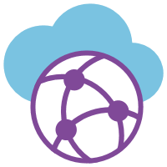
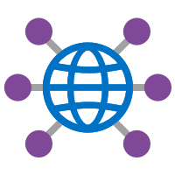


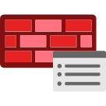


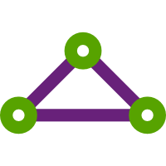


Network Topology & Connectivity
3. Define an Azure Networking Topology 4. Connectivity to Azure
A. Azure Virtual WAN Based Networking Topology B. Traditional Azure Networking Topology
Connectivity Subscription (Global)
Regions: North Europe (neu), West Europe (weu), North Central US (ncus)
Virtual WAN
contoso-global-vwan
contoso-global-ddos
contoso-vwan
contoso-vhub-<region>
contoso-fw-policy-global
contoso-fw-<region>
contoso-ddos-std-plan
NetworkWatcherRG
contoso-global-dns
contoso-er-circuits
Azure Monitor
Define your Network Typology
Network Watcher
azure.contoso.com
contoso-er-circuit-<region>
Security Center
D1
Notes:
Network topology and connectivity within Enterprise-scale addresses the need for establishing the end-to-end connectivity for all landing zones in the enterprise Azure estate. The subject is both broad and complex and will likely consume a significant portion of the overall design effort. It is critical for successful delivery to ensure that you have a thorough understanding of all design areas and Enterprise-scale recommendations, common alternative solutions, and the impact of deviating from the recommendations.
DNS Configuration within Enterprise-scale will be primarily influenced by the cross-premises name resolution requirements of landing zone workloads. For environments where name resolution in Azure is all that is required, native Azure DNS services should suffice. For environments where name resolution across Azure and on-premises is required, Azure VMs integrated with existing DNS infrastructure will be required. Integration with Private Link and services with special DNS requirements, such as OpenShift, must also be factored into the design.
Tip – A common scenario here is customer extends their DNS infra to Azure (Infoblox, AD, etc) but also uses the azure DNS resolver 168.* address as a forwarder for those in-azure DNS servers to assure private link resolution.
Azure Networking Topology
Azure Virtual WAN An Azure networking topology based-on Azure Virtual WAN is the preferred Enterprise Scale approach for large scale multi-region deployments where the customer needs to interconnect all their global locations on both Azure and on-premises. Azure Virtual WAN provides multiple advantages over traditional Azure networking, including:
Azure Virtual WAN is a Microsoft-managed solution, where end-to-end global transit connectivity is provided out-of-the-box. Virtual WAN Hubs eliminate the need for customers to manually setup the network connectivity. As an example, customer does not require to setup UDRs or NVAs to enable global transit connectivity.
Azure Virtual WAN greatly simplifies end-to-end network connectivity in Azure and cross-premises by creating a hub and spoke network architecture that spans multiple Azure regions and on-premises locations (any-to-any connectivity) out-of-the-box.
Azure Virtual WAN increases the limit of up to 200 prefixes advertised from Azure to on-premises via ExpressRoute Private Peering to 10,000 prefixes per single Virtual WAN Hub. The limit of 10,000 prefixes also includes VPN (S2S and P2S VPN).
Traditional Azure Networking can also be used to build a secure network foundation aligned to the Enterprise Scale design principles. A traditional Azure networking topology should be used for customers that either:
only intend to deploy resources in a few Azure regions
have no need for a global interconnected network
have a low number of remote/branch locations per region (less than 30), and/or
require full control and granularity for manually configuring their Azure network.
Tip: The decision point here is usually boils down to two things; do you want managed transit networking? If yes, then vwan. Do you need to ensure vnets cannot communicate with each other by default? (if so hub/spoke), but the details above will also impact the decision. Making sure the customer is aware of the differences will lead to the right conversation to make the decision.
Connectivity to Azure is concerned with establishing private connectivity from on-premises locations to Azure. Private connectivity options include ExpressRoute, ExpressRoute Global Reach, ExpressRoute Direct, Site-to-Site VPN, and Point-to-Site VPN. It will be necessary to fully understand the customer's various connectivity scenarios to align feature capabilities with customer requirements. Enterprise-scale design recommendations include:
Use ExpressRoute as the primary connectivity channel for connecting on-premises network to Microsoft Azure.
VPNs can be used as a source of backup connectivity to enhance connectivity resiliency and/or as a short-term solution while ExpressRoute ‘last mile’ connectivity is provisioned for customers that are not already either in a provider facility or have connectivity with an ER provider.
Use ExpressRoute Global Reach to connect large offices /regional headquarters/datacenter that are connected to Azure via ExpressRoute.
Do not use the same ExpressRoute circuit to connect multiple environments that require isolation or dedicated bandwidth, so as to avoid "noisy neighbour" risks.
Tip: A wise CSA once said “There are two types of enterprise Azure customers. Those with express route and those using a VPN while waiting for last mile connectivity.” A VPN backup of ExpressRoute is a great solution as well, but customers can also use multiple ER circuits at multiple peering locations. VPN is not a good backup to ER if the customer has the same provider for ER as for internet breakout as a provider outage will impact both.
Connectivity to Azure PaaS services can come in many forms and each service in the customer's Azure estate should be examined to ensure their requirements are met by the connectivity design. Azure PaaS services are typically accessed over public endpoints, though many PaaS services provide capabilities to secure such endpoints or even make them entirely private.
Private Link provides dedicated access using private IP addresses to Azure PaaS instances, or custom services behind an Azure Load Balancer Standard.
VNet injection provides dedicated private deployments for supported services. However, management plane traffic flows through public IP addresses. It is critical to understand how traffic routing within a virtual network can influence the management plane traffic in this scenario and affect the stability of the service.
VNet Service Endpoints provide service level access from selected subnets to selected PaaS services. When using Service Endpoints it is important to ensure concerns with data exfiltration are addressed.
Tip: Most enterprises will want to use private link wherever possible as the existence of a public IP perceived is a level of risk.
Planning for Inbound and Outbound Internet Connectivity often involves separating customers from their existing on-premises tools and practices. For example, customers will frequently want to force tunnel egress traffic back on-premises for inspection or replicate on-premises DMZ architectures in Azure. This is where we rely on the Enterprise-scale design principles to drive to a better architecture.
Azure native network security services such as Azure Firewall, Application Gateway WAF, and Azure Front Door WAF are fully managed services, meaning that customers do not incur the operational and management costs associated with infrastructure deployments, which can become complex at scale.
The Enterprise Scale architecture is fully compatible with 3rd party NVAs, should the customer prefer to use NVAs or for situations where native services do not satisfy specific customer requirements.
Tip: Many enterprise customers have 100’s of 3rd party firewalls deployed and want to maintain that ‘single pain of glass’ management for Azure. While this works and is supported 3rd party NVAs generally don’t scale as well as cloud native/first party products. Some customers have then used first party for use cases where business needs demanded better scale/throughput.
Planning for Application Delivery focuses on application delivery within the landing zone. From the Enterprise-scale perspective, application delivery services, such as Application Gateway and Front Door, are an application component and should reside within the landing zone and be managed by the application owners. By leverage Azure Policy to ensure complaint service configuration, the customer maintain central governance while enabling the business.
Azure Load Balancer (internal and public) provides high availability for application delivery at a regional level.
Azure Application Gateway allows the secure delivery of HTTP/S applications at a regional level.
Azure Front Door allows the secure delivery of highly available HTTP/S applications across Azure regions.
Azure Traffic manager allows the delivery of global applications.
It is recommended to use the WAF capabilities provided by Application Gateway and Front Door. When using both services, it is recommended to use AFD WAF, placing the protection closer to the edge.
Azure DDoS standard is recommended on all public endpoints within customer virtual networks.
Tip: A global web app would use front door to connect the user to the closest edge, then application gateway to load balance in the destination azure region.
Planning for Landing Zone Network Segmentation explores key recommendations to deliver highly secure internal network segmentation within a "Landing Zone" to drive a network Zero Trust implementation.
The Zero Trust model assumes a breached state and verifies each request as though it originates from an uncontrolled network.
An advanced Zero Trust network implementation employs fully distributed ingress/egress cloud micro-perimeters and deeper micro-segmentation.
Network Security Groups can use Azure Service Tags to facilitate connectivity to Azure PaaS services.
Use NSGs and ASGs to microsegment traffic within the "Landing Zone" and avoid using a central NVA to filter these traffic flows.
It is recommended to enable NSG Flow Logs and feed them into Traffic Analytics to gain insights into internal and external traffic flows.
For VWAN-based network topologies, route traffic across "Landing Zones" via Azure Firewall only if the customer requires filtering and logging capabilities for traffic flowing across "Landing Zones".
Tip: NSGs can be used to implement zero trust principles but keep in mind they don’t inspect traffic (I.E. if the NSG is allow 443 and a bad actor tunnels ssh through 443, the nsg will allow it where a NGFW would block it).
Network Encryption explores key recommendations to achieve network encryption between on-premises and Azure as well as across Azure regions.
Cost and available bandwidth are inversely proportional to length of encryption tunnel between endpoints.
When using VPN to connect to Azure, traffic is encrypted over the internet via IPsec tunnels.
When using ExpressRoute with Private Peering, traffic is not currently encrypted.
MACsec encryption can be applied to ExpressRoute Direct to achieve network encryption.
Azure does not currently offer native encryption over Global VNet Peering.
Tip: Ipsec can also be used on individual VMs to encrypt traffic. Also, many customers falsely assume every bit of traffic in any public cloud is encrypted by default (like storage is).
Traffic Inspection - In many industries customers require that traffic in Azure, particularly inbound and outbound internet traffic, is mirrored to a network packet collector for deep inspection and analysis. This section therefore explores key considerations and recommended approaches for mirroring or tapping traffic within Azure Virtual Networks.
Azure Virtual Network TAP (VTAP) is in preview, but your must reach to azurevnettap@microsoft.com for availability details.
Network Watcher packet captures in Network Watcher is GA, but captures are limited to a maximum period of 5 hours.
Use Network Watcher packet capture despite the limited capture window.
Evaluate if NSG Flow Logs v2 provide the level of detail required.
Use 3rd party solutions for scenarios where sustained deep packet inspection is required.
Do not develop a custom solution to mirror traffic. While this might be acceptable for small scale scenarios, this approach is not encouraged at scale due to complexity and supportability issues which may arise.
Tip: Any enterprise with a requirement for ‘deep packet inspection’ is going to use a 3rd party NVA until azfw supports it (NDA roadmap).

Slide 31
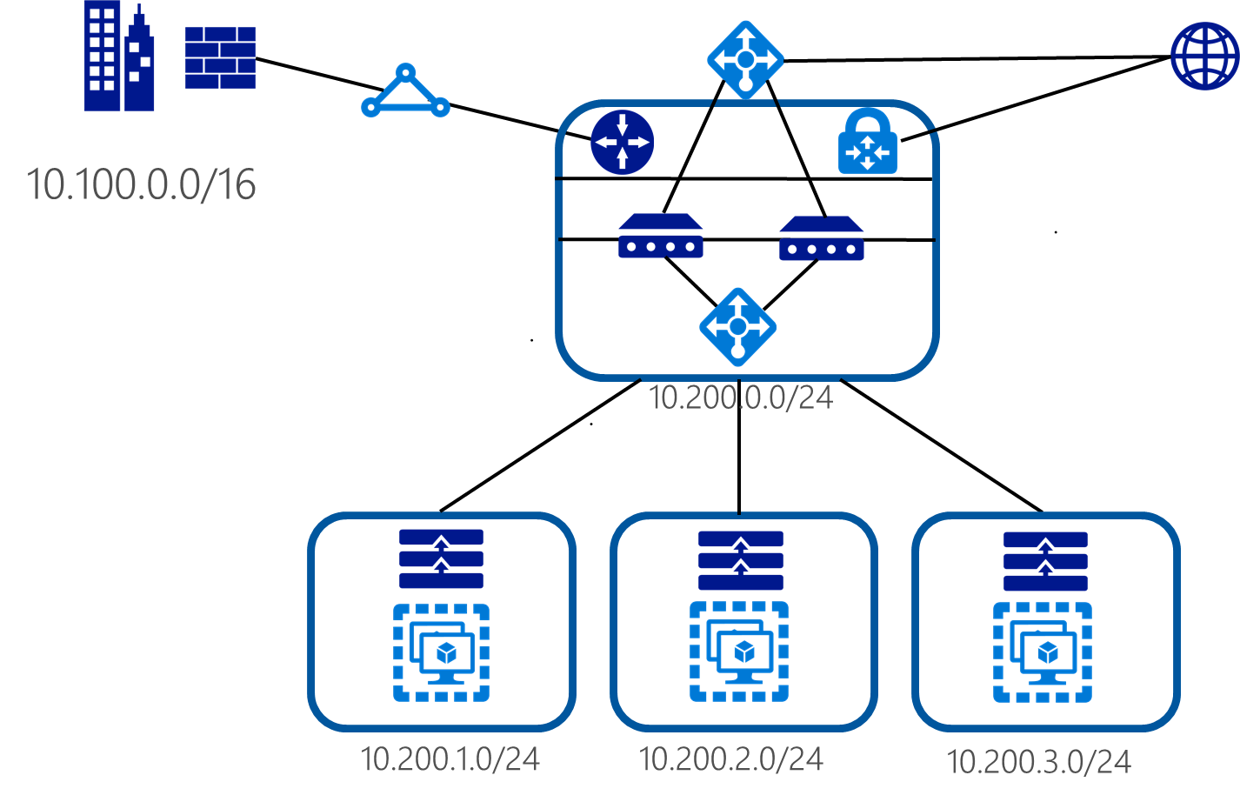
Network Topology & Connectivity
Azure Region = 10.200.0.0/16
IP Addressing
D2
Notes:
Planning for IP Addressing is the vital first step of Enterprise-scale network design. Many enterprises are IP constrained and having a detailed plan incorporated into the network design at the outset will help prevent a painful redesign and migration exercise. Key considerations include overlapping address ranges, Azure default IP consumption, IPv6, and Azure services requiring dedicated subnets.
The image shows an on prem network at 10.100.0.0/16 with an azure region assigned 10.200.0.0/16 and the hub and spokes carved out as /24s.
Tip: One customer assigned 10.8.0.0/16 for azure use, but didn’t split it out by region so 10.8.1.0 was US East and 10.8.2.0 was UK North, etc. This caused a lot of routing headaches, so be sure to plan by region.
Plan for non-overlapping IP address spaces across Azure regions and on-premises locations well in advance.
Use IP addresses from the address allocation for private internets (RFC 1918).
For environments with limited private IP addresses (RFC 1918) availability, consider using IPv6.
Do not create unnecessarily large VNets (for example: /16) to ensure that IP address space isn't wasted.
Do not create VNets without planning the required address space in advance, since adding address space will cause an outage once a VNet is connected via virtual network peering.
Do not use public IP addresses for VNets, especially if the public IP addresses don't belong to the customer.

Slide 32
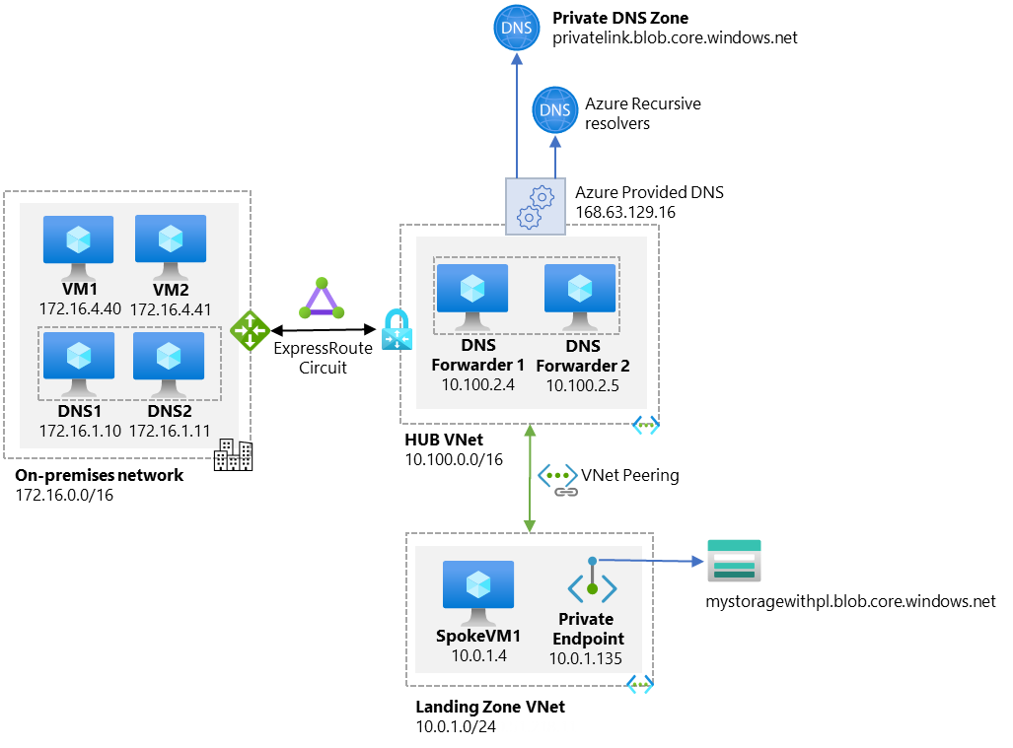
Network Topology & Connectivity
Example: DNS resolution flow when a VM in a VNET tries to resolve private endpoint:
DNS
D3
Notes:
Key take away is that you must have some sort of resolver in Azure to resolve private link names!
DNS on prem only will lead to resiliency issues as many applications will be dependant on name resolution
Nginx DNS proxy: https://github.com/microsoft/PL-DNS-Proxy
Design recommendations:
For environments where name resolution in Azure is all that's required, use Azure Private DNS for resolution by creating a delegated zone for name resolution (such as azure.contoso.com).
For environments where name resolution across Azure and on-premises is required, use existing DNS infrastructure (for example, Active Directory integrated DNS) deployed onto at least two Azure VMs and configure DNS settings in VNets to use those DNS servers.
Azure Private DNS can still be used where the Azure Private DNS zone is linked to the VNets and DNS servers are used as hybrid resolvers with conditional forwarding to on-premises DNS names (such as onprem.contoso.com) using on-premises DNS servers. On-premises servers can be configured with conditional forwarders to resolver VMs in Azure for the Azure Private DNS zone (for example, azure.contoso.com).
Special workloads that require and deploy their own DNS (such as Red Hat OpenShift) should use their preferred DNS solution.
Auto-registration should be enabled for Azure DNS to automatically manage the lifecycle of the DNS records for the virtual machines deployed within a VNet.
Use a virtual machine as a resolver for cross-premises DNS resolution with Azure Private DNS.
Create the Azure Private DNS zone within a global connectivity subscription. Additional Azure Private DNS zones might be created (for example, privatelink.database.windows.net or privatelink.blob.core.windows.net for Azure Private Link).

Slide 33
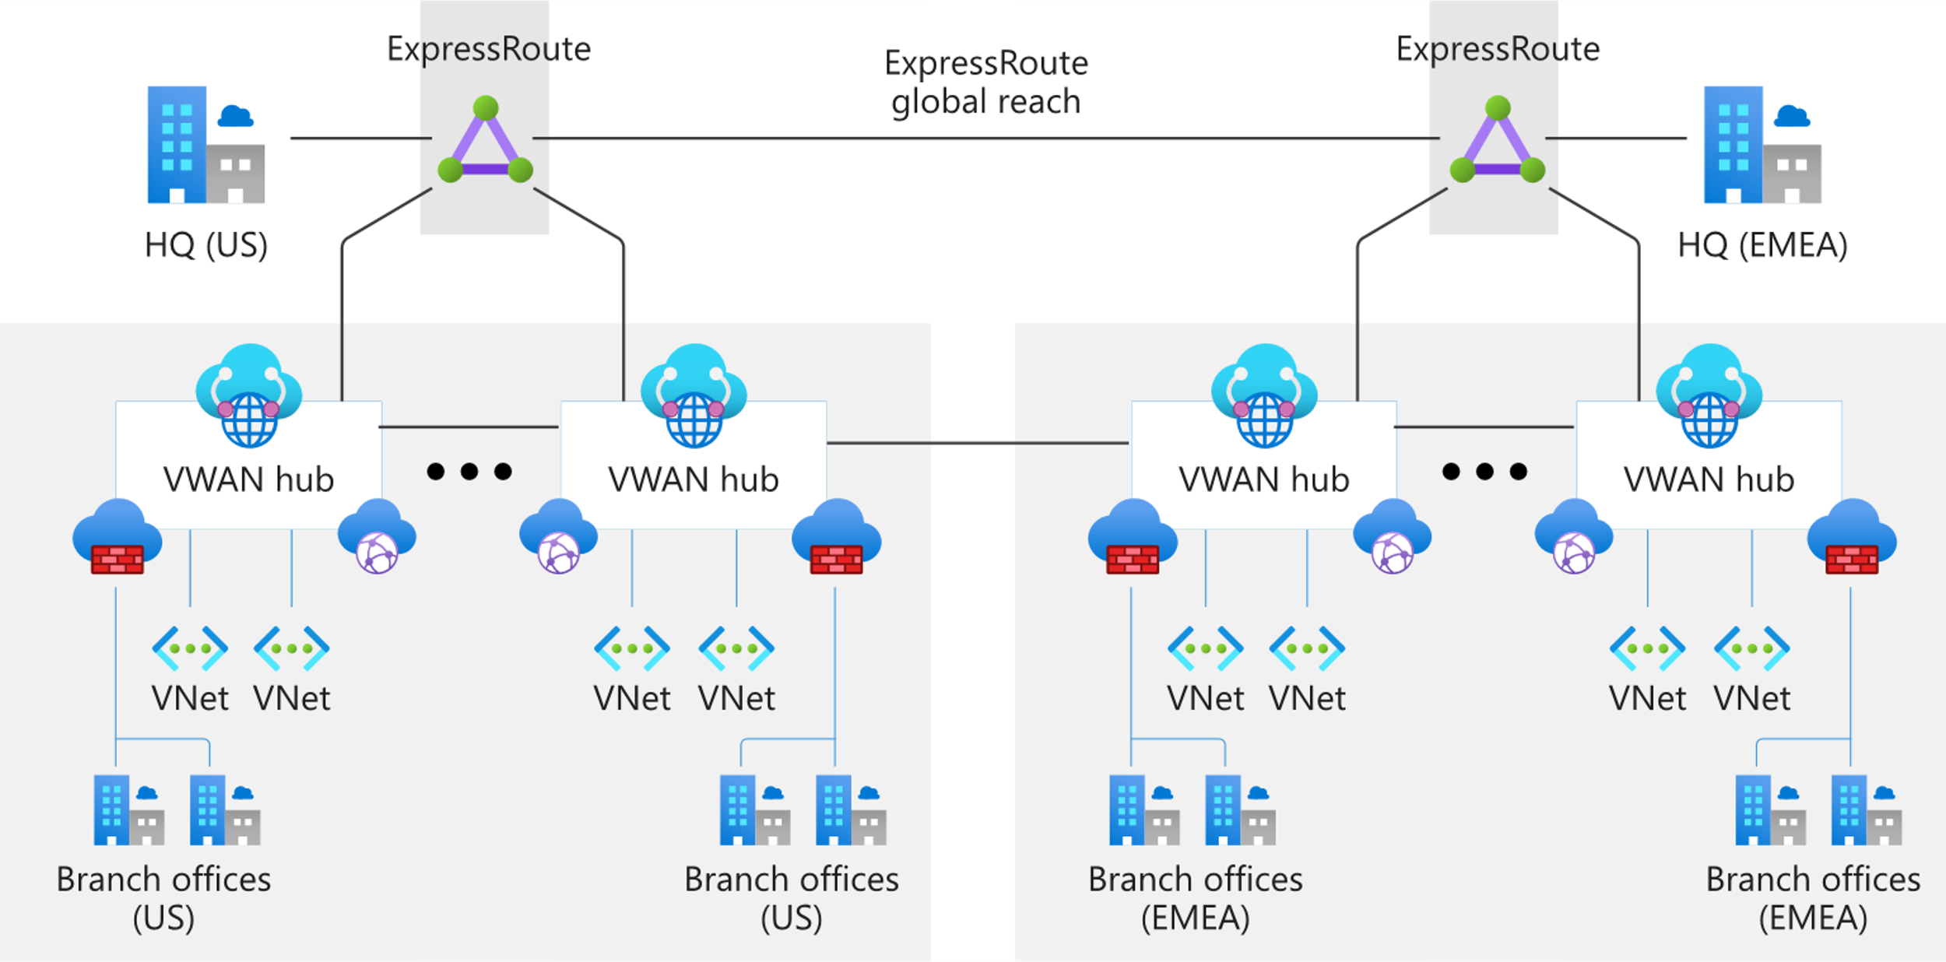
Network Topology & Connectivity
Virtual WAN Global Transit Network
Virtual Wan
D4
Notes:
Design recommendations:
Virtual WAN is highly recommended for new large/global network deployments in Azure where customers require global transit connectivity across Azure regions and on-premises locations, without having to manually setup Azure networking transitive routing by themselves.
Use Virtual WAN as a global connectivity resource, with a Virtual WAN hub per Azure region to connect multiple landing zones together across Azure regions via their local Virtual WAN hub.
Connect Virtual WAN hubs to on-premises datacenters using ExpressRoute.
Connect branches and remote locations to the nearest Virtual WAN hub via site-to-site VPN, or enable branch connectivity to Virtual WAN via an SD-WAN partner solution.
Connect end users to the Virtual WAN hub via a point-to-site VPN.
Follow the principle, "traffic in Azure stays in Azure" so that communication across resources in Azure occurs via the Microsoft backbone network, even when the resources are in different regions.
Deploy Azure Firewall in Virtual WAN hubs for east-west and south-north traffic protection/filtering within an Azure region.
If third-party NVAs are required for east-west and/or south-north traffic protection/filtering, deploy the NVAs to a separate VNet (such as an NVA VNet), and connect it to the regional Virtual WAN hub and to the landing zones requiring access to NVAs. For more information, see Create a Virtual WAN hub route table for NVAs.
When deploying third-party networking technologies and NVAs, follow the third-party vendor's guidance to ensure there aren't conflicting configurations with Azure networking.
Do not build a transit network on top of Azure Virtual WAN, because Virtual WAN satisfies all transitive network topology requirements including the ability to use third-party NVAs.
Don't use existing on-premises networks like multiprotocol label switching (MPLS) to connect Azure resources across Azure regions, as Azure networking technologies support the interconnection of Azure resources across regions through the Microsoft backbone.
For brownfield scenarios where you're migrating from a hub-and-spoke network topology not based on Virtual WAN, see
Private DNS zones might be created (for example, privatelink.database.windows.net or privatelink.blob.core.windows.net for Azure Private Link).

Slide 34
Network Topology & Connectivity
Virtual WAN Global Transit Network
Virtual Wan
Notes:
Design recommendations:
Virtual WAN is highly recommended for new large/global network deployments in Azure where customers require global transit connectivity across Azure regions and on-premises locations, without having to manually setup Azure networking transitive routing by themselves.
Use Virtual WAN as a global connectivity resource, with a Virtual WAN hub per Azure region to connect multiple landing zones together across Azure regions via their local Virtual WAN hub.
Connect Virtual WAN hubs to on-premises datacenters using ExpressRoute.
Connect branches and remote locations to the nearest Virtual WAN hub via site-to-site VPN, or enable branch connectivity to Virtual WAN via an SD-WAN partner solution.
Connect end users to the Virtual WAN hub via a point-to-site VPN.
Follow the principle, "traffic in Azure stays in Azure" so that communication across resources in Azure occurs via the Microsoft backbone network, even when the resources are in different regions.
Deploy Azure Firewall in Virtual WAN hubs for east-west and south-north traffic protection/filtering within an Azure region.
If third-party NVAs are required for east-west and/or south-north traffic protection/filtering, deploy the NVAs to a separate VNet (such as an NVA VNet), and connect it to the regional Virtual WAN hub and to the landing zones requiring access to NVAs. For more information, see Create a Virtual WAN hub route table for NVAs.
When deploying third-party networking technologies and NVAs, follow the third-party vendor's guidance to ensure there aren't conflicting configurations with Azure networking.
Do not build a transit network on top of Azure Virtual WAN, because Virtual WAN satisfies all transitive network topology requirements including the ability to use third-party NVAs.
Don't use existing on-premises networks like multiprotocol label switching (MPLS) to connect Azure resources across Azure regions, as Azure networking technologies support the interconnection of Azure resources across regions through the Microsoft backbone.
For brownfield scenarios where you're migrating from a hub-and-spoke network topology not based on Virtual WAN, see
Private DNS zones might be created (for example, privatelink.database.windows.net or privatelink.blob.core.windows.net for Azure Private Link).

Slide 35
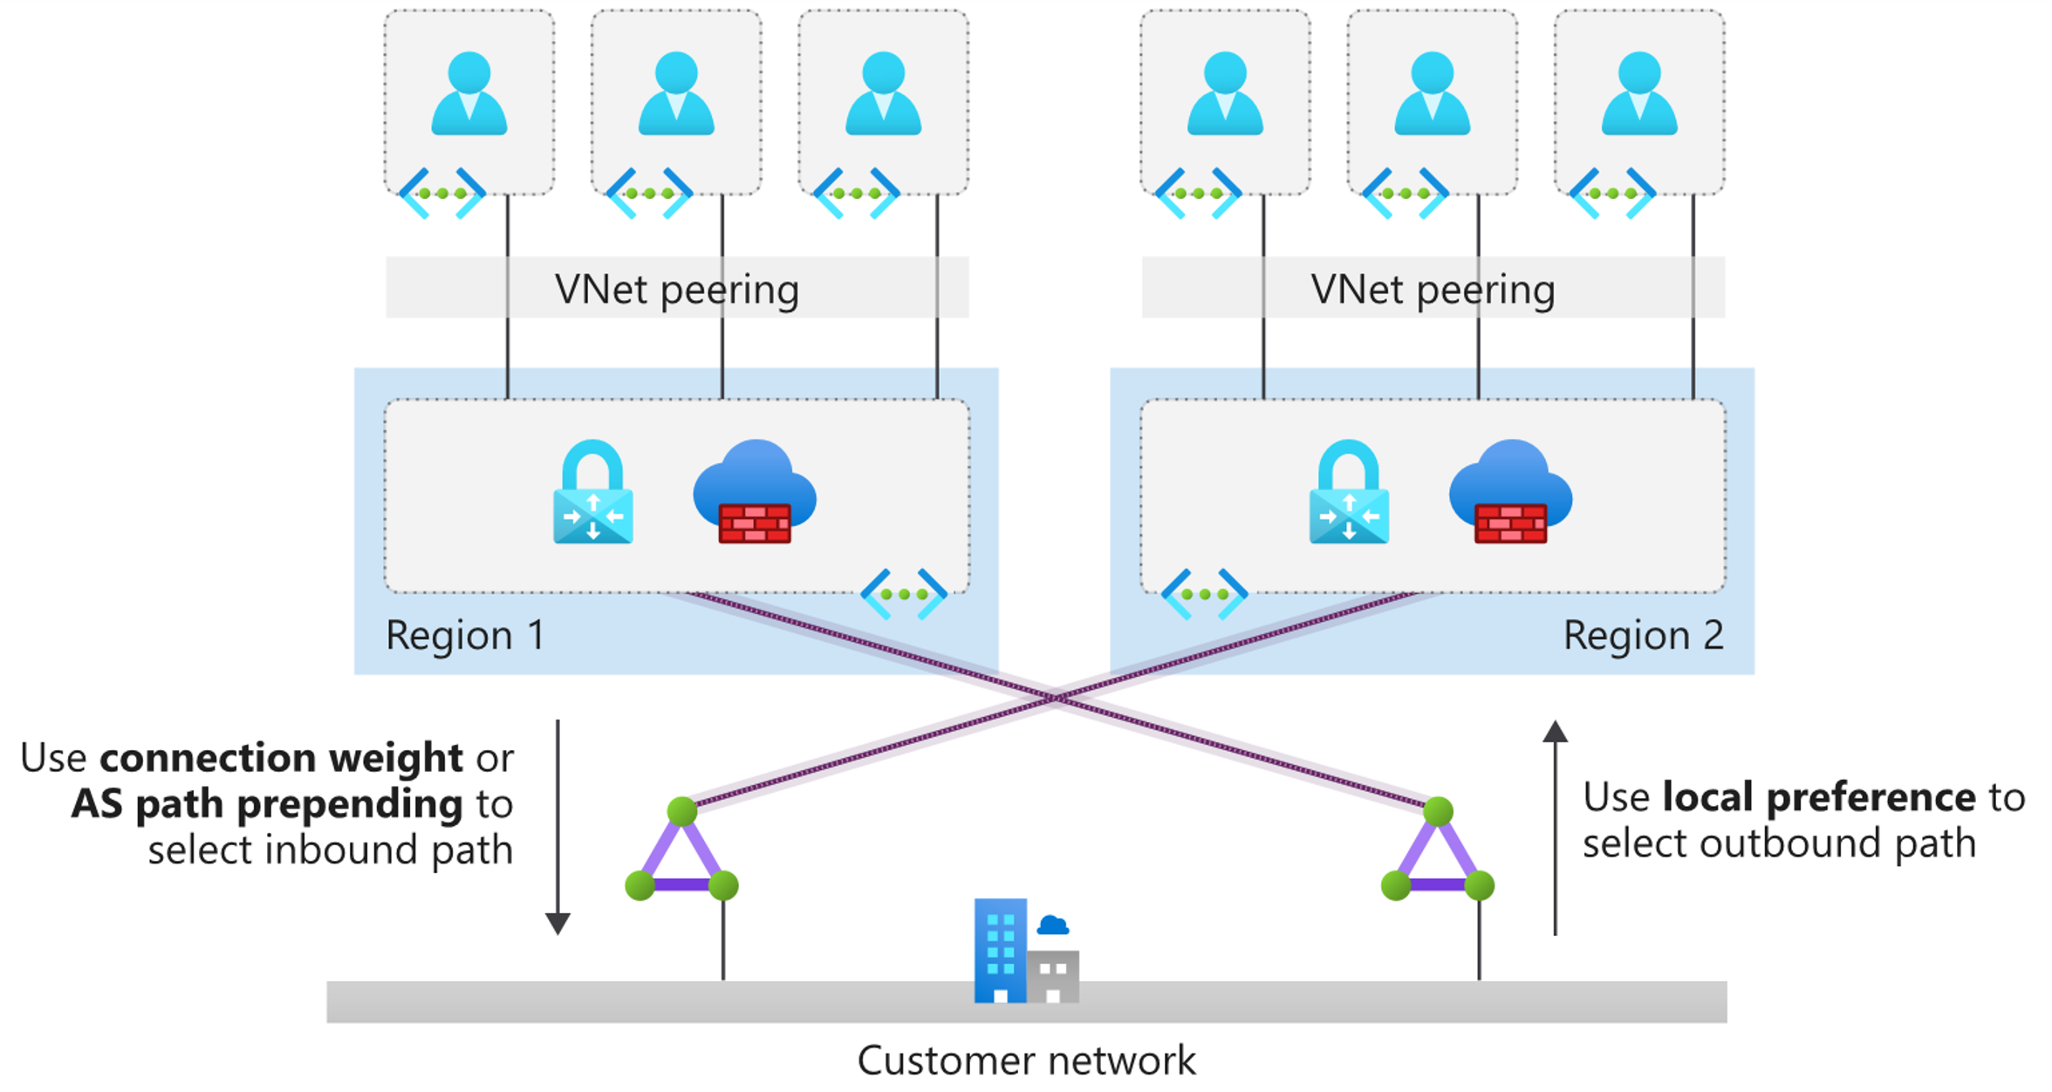
Network Topology & Connectivity
Hub and Spoke
D5
Notes:
Design recommendations:
Use ExpressRoute as the primary connectivity channel for connecting on-premises network to Microsoft Azure. VPNs can be used as a source of backup connectivity to enhance connectivity resiliency.
Use dual ExpressRoute circuits from different peering locations when connecting an on-premises location to VNets in Azure. This setup will ensure redundant paths to Azure, removing single points of failure between on-premises and Azure.
When multiple ExpressRoute circuits are used, optimize ExpressRoute routing via BGP local preference and AS PATH prepending.
Ensure the right SKU is used for the ExpressRoute/VPN gateways based on bandwidth and performance requirements.
Deploy a zone redundant ExpressRoute gateway in the supported Azure regions.
For scenarios that require bandwidth higher than 10 Gbps or dedicated 10/100 Gbps ports, use ExpressRoute Direct.
When low latency is required, or throughput from on-premises to Azure must be greater than 10 Gbps, enable FastPath to bypass the ExpressRoute gateway from the data path.
Use VPN gateways to connect branches or remote locations to Azure. For higher resilience, deploy zone-redundant gateways (where available).
Use ExpressRoute Global Reach to connect large offices/regional headquarters/datacenters connected to Azure via ExpressRoute.
When traffic isolation or dedicated bandwidth is required (such as for separating production and nonproduction environments), different ExpressRoute circuits should be used to ensure isolated routing domains and to alleviate noisy-neighbor risks.
Proactively monitor ExpressRoute circuits using Network Performance Monitor.
Do not explicitly use ExpressRoute circuits from a single peering location, as this creates a single point of failure and makes the customer susceptible to peering location outages.
Do not use the same ExpressRoute circuit to connect multiple environments that require isolation or dedicated bandwidth to avoid noisy-neighbor risks.
.database.windows.net or privatelink.blob.core.windows.net for Azure Private Link).

Slide 36
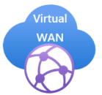
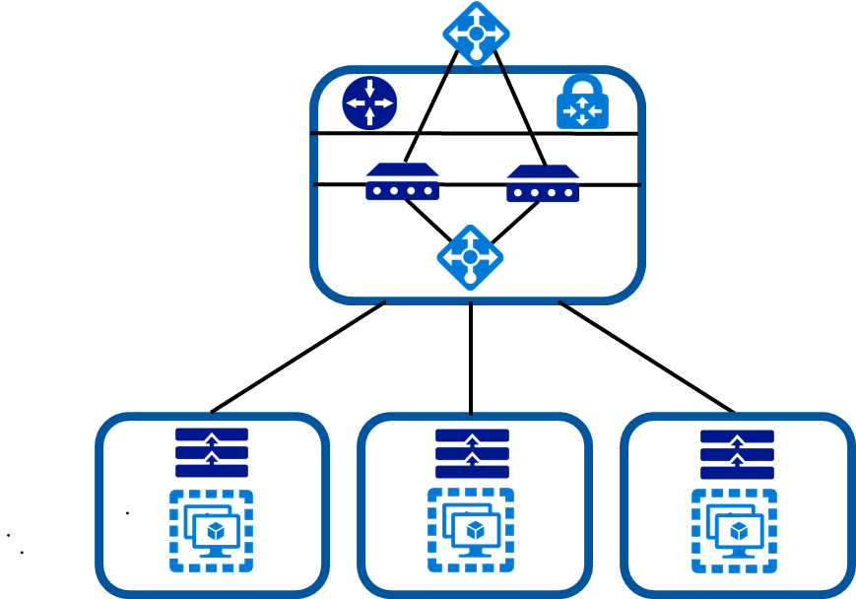
Network Topology & Connectivity
Is there a need for branch to branch connectivity?
Is there a need granular control of connectivity?
Choose
Notes:
While Virtual WAN offers a wide range of powerful capabilities, there are some cases where a traditional Azure networking approach may be optimal:
If a global transitive network across multiple Azure regions or cross-premises isn't required, such as a branch in the United States requiring connectivity to a virtual network in Europe.
If there isn't a need to connect to a large number of remote locations via VPN or integration with an SD-WAN solution.
If the customer's preference is to have granular control and configuration when setting up a network topology in Azure.

Slide 37
Network Topology & Connectivity
Use ExpressRoute as the primary connectivity
When over 10gbps is needed use ExpressRoute Direct
Use multiple peering locations for resiliency
Enable Fast Path to lower latency
Connectivity to Azure
D6
Notes:
Use ExpressRoute as the primary connectivity channel for connecting on-premises network to Microsoft Azure. VPNs can be used as a source of backup connectivity to enhance connectivity resiliency.
Use dual ExpressRoute circuits from different peering locations when connecting an on-premises location to VNets in Azure. This setup will ensure redundant paths to Azure, removing single points of failure between on-premises and Azure.
When multiple ExpressRoute circuits are used, optimize ExpressRoute routing via BGP local preference and AS PATH prepending.
Ensure the right SKU is used for the ExpressRoute/VPN gateways based on bandwidth and performance requirements.
Deploy a zone redundant ExpressRoute gateway in the supported Azure regions.
For scenarios that require bandwidth higher than 10 Gbps or dedicated 10/100 Gbps ports, use ExpressRoute Direct.
When low latency is required, or throughput from on-premises to Azure must be greater than 10 Gbps, enable FastPath to bypass the ExpressRoute gateway from the data path.
Use VPN gateways to connect branches or remote locations to Azure. For higher resilience, deploy zone-redundant gateways (where available).
Use ExpressRoute Global Reach to connect large offices/regional headquarters/datacenters connected to Azure via ExpressRoute.
When traffic isolation or dedicated bandwidth is required (such as for separating production and nonproduction environments), different ExpressRoute circuits should be used to ensure
isolated routing domains and to alleviate noisy-neighbor risks.
Proactively monitor ExpressRoute circuits using Network Performance Monitor.
Do not explicitly use ExpressRoute circuits from a single peering location, as this creates a single point of failure and makes the customer susceptible to peering location outages.
Do not use the same ExpressRoute circuit to connect multiple environments that require isolation or dedicated bandwidth to avoid noisy-neighbor risks.
control and configuration when setting up a network topology in Azure.

Slide 38
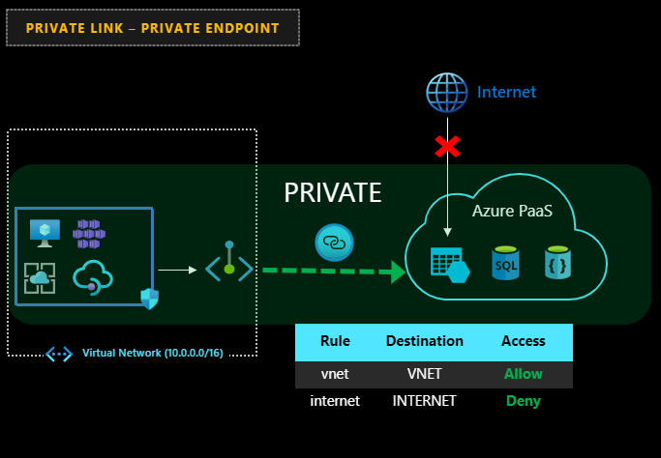
Network Topology & Connectivity
Connectivity to PaaS services
D7
Notes:
Use VNet injection for supported Azure services to make them available from within a customer VNet.
Azure PaaS services that have been injected into a VNet still perform management plane operations using public IP addresses. Ensure that this communication is locked down within the VNet using UDRs and NSGs.
Use Private Link, where available, for shared Azure PaaS services. Private Link is generally available for several services and is in public preview for numerous ones. Private Link availability is detailed here.
Access Azure PaaS services from on-premises via ExpressRoute private peering, using either VNet injection for dedicated Azure services or Azure Private Link for available shared Azure services. To access Azure PaaS services from on-premises when VNet injection or Private Link aren't available, use ExpressRoute with Microsoft peering. This would avoid transiting over the public internet.
Use VNet service endpoints to secure access to Azure PaaS services from within a customer VNet, but only when Private Link isn't available and there aren't data exfiltration concerns. To address data exfiltration concerns with service endpoints, use NVA filtering or use VNet service endpoint policies for Azure Storage.
Do not enable VNet service endpoints by default on all subnets.
Do not use VNet service endpoints when there are data exfiltration concerns, unless NVA filtering is used.
It isn't recommended to implement forced tunneling to enable communication from Azure to Azure resources.

Slide 39
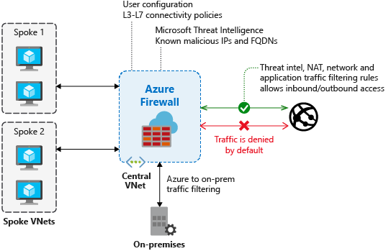
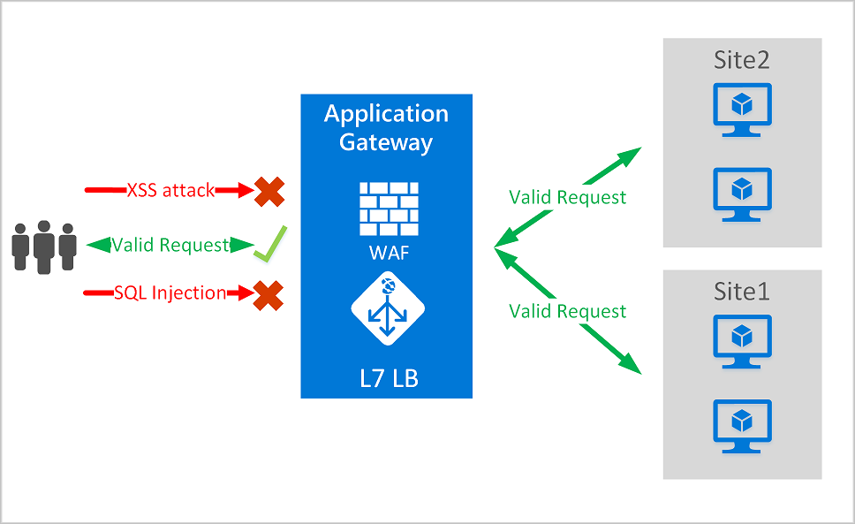
Network Topology & Connectivity
Azure Firewall and WAF
Internet Connectivity
D8
Notes:
Use Azure Firewall to govern:
Azure outbound traffic to the internet
Non-HTTP/S inbound connections
East-west traffic filtering (if required by the customer)
Use Firewall Manager with Virtual WAN to deploy and manage Azure firewalls across Virtual WAN hubs or in hub VNets. Firewall Manager is currently in preview for both Virtual WAN and regular VNets.
Create a global Azure Firewall policy to govern security posture across the global network environment and assign it to all Azure Firewall instances. Allow for granular policies to meet requirements of specific regions by delegating incremental firewall policies to local security teams via RBAC.
Configure supported third-party SaaS security providers within Firewall Manager if the customer wishes to use such solutions to protect outbound connections.
Use WAF within a landing zone VNet for protecting inbound HTTP/S traffic from the internet.
Use Azure Front Door and WAF policies to provide global protection across Azure regions for inbound HTTP/S connections to a landing zone.
When using Azure Front Door and Azure Application Gateway to protect HTTP/S apps, use WAF policies in Azure Front Door and lock down Azure Application Gateway to receive traffic only from Azure Front Door.
If third-party NVAs are required for east-west and/or south-north traffic protection/filtering:
For Virtual WAN network topologies, deploy the NVAs to a separate VNet (for example, NVA VNet), and connect it to the regional Virtual WAN hub and to the landing zones that require access to NVAs, as described in this article. For non-Virtual WAN network topologies, deploy the third-party NVAs in the central hub VNet.
If third-party NVAs are required for inbound HTTP/S connections, they should be deployed within a landing zone VNet and together with the apps that they're protecting and exposing to the internet.
Use Azure DDoS Protection Standard protection plans to protect all public endpoints hosted within customer VNets.
Do not replicate on-premises DMZ concepts and architectures into Azure, as customers can get similar security capabilities in Azure as with on-premises, but the implementation and architecture will need to be adapted to the cloud.
in Azure.

Slide 40
Network Topology & Connectivity
Landing zone owners should be able to create subnets and manage NSGs
Use NSG flow logs and traffic analytics
Use ASGs for intra-vnet controls
Inter-landing zone traffic can be NSG, Azure Firewall or NVA
Deploy WAFs inside landing zones
Segmentation
D9 – D10
Notes:
Delegate subnet creation to the landing zone owner. This will enable them to define how to segment workloads across subnets (for example, a single large subnet, multitier app, or VNet-injected app). The platform team can use Azure Policy to ensure an NSG with specific rules (such as deny inbound SSH or RDP from internet, or allow/block traffic across landing zones) is always associated to subnets with deny-only policies.
NSGs must be used to protect traffic across subnets, as well as east-west traffic across the platform (inter-landing-zone traffic).
The app team should use app security groups at the subnet level NSGs to protect multitier VMs within their landing zone.
Use NSGs and app security groups to micro-segment traffic within the landing zone and avoid using a central NVA to filter traffic flows.
Enable NSG flow logs and feed them into Traffic Analytics to gain insights into internal and external traffic flows.
Use NSGs to selectively whitelist inter-landing-zone connectivity.
For Virtual WAN topologies, route traffic across landing zones via Azure Firewall if the customer requires filtering and logging capabilities for traffic flowing across landing zones.

Slide 41
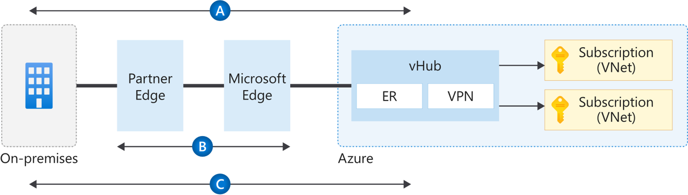
Network Topology & Connectivity
Use MACSEC for ER Direct customers
IPSEC over ExpressRoute without MSFT peering is coming soon (NDA)
VNET to VNET VPN for inter-landing zone encryption
Encryption Options
D11
Notes:
When establishing VPN connections from on-premises to Azure using VPN gateways, traffic is encrypted at a protocol level using IPsec tunnels, as depicted in Flow A in the diagram above.
When using ExpressRoute Direct, configure media access control security (MACsec) in order to encrypt traffic at the layer-two level between the customer's routers and MSEE, as depicted in Flow B in the diagram above.
For Virtual WAN scenarios where MACsec isn't an option (for example, not using ExpressRoute Direct), use Virtual WAN VPN gateway to establish IPsec tunnels over ExpressRoute private peering. This is depicted by Flow C in the diagram above.
For non-virtual-WAN scenarios, and where MACsec isn't an option (for example, not using ExpressRoute Direct), today the only options is to use third-party NVAs to establish IPsec tunnels over ExpressRoute private peering or establish a VPN tunnel over ExpressRoute with Microsoft peering.
If traffic between Azure regions must be encrypted, use VPN gateways to connect VNets across regions.
Use third-party NVAs in Azure to encrypt traffic over ExpressRoute private peering in case native solutions offered in Azure (as depicted in flows B and C above) do not meet customer requirements.

Slide 42
Azure landing zones Design areas
Azure billing & Active Directory tenant
Security
Identity & access management
Governance
ENVIRONMENT
COMPLIANCE
Resource organization
Management
Network topology & connectivity
Platform automation & DevOps
Notes:
There are different Azure landing zone implementation options and each of them provide a different deployment approach. Before choosing an implementation option, let’s talk about the design areas for Azure landing zones.

Slide 43
8 Critical Design Areas
Azure Billing and Active Directory
Identity and Access Management
Resource Organization
Network Topology and Connectivity
Management
Governance
Security
Platform Automation and DevOps

Slide 44
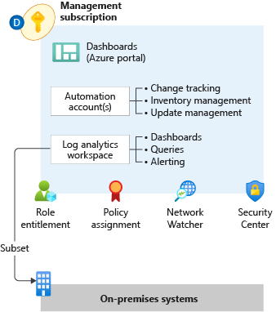

Management
Planning for Platform & Application Management and Monitoring
Log Analytics workspace is an administrative boundary Security audit logging and achieving a horizontal security lens across the entire customer Azure estate
Azure data retention thresholds and requirements for archiving
F1
Notes:
Management & monitoring in Enterprise-scale is primarily concerned with how an enterprise can operationalize and centrally govern their Azure estate. Management and monitoring recommendations align to the Enterprise-scale design principles and focus on native Azure capabilities. Where customers deviate from recommendations, it is important to highlight the design complexities, administrative burden, gaps in observability, and costs of third-party solutions. Defaulting to a customer’s existing toolset often proves challenging and slows adoption.
Role Entitlement
Role entitlement refers to the implementation of fine-grained RBAC controls, with appropriate access at the appropriate scope, in conjunction with PIM and aligned with the operating model. Within the context of the Management subscription, the focus of Enterprise-scale is on providing central IT with visibility across the platform to ensure the enterprise Azure estate can be operationally maintained. Areas of visibility include audit logs, patch status, and security alerts.
Policy Assignment
Policy assignments establish the guard rails that allow for subscription management to be distributed while remaining centrally governed, enabling subscription democratization. Within the context of the Management subscription, the focus of Enterprise-scale is on ensuring the appropriate resources are in place and ready for consumption by platform services and landing zones.
Archetype Templates
Management and monitoring within Enterprise-scale must be designed with application archetypes in mind. Every large-scale enterprise software estate will encompass a myriad of application archetypes, and each archetype may require a different migration/transformation path to Azure; a VM workload is not migrated the same way as SAP workloads. The management and monitoring design must account for these differences to ensure the proper guard rails and observability are in place and ready to consume at time of landing zone deployment.
Azure Monitor Logs (aka Log Analytics)
Centralized logging is critical to the visibility that's required by the operations management teams. The centralization of logging drives reports about change management, service health, configuration, and most other aspects of IT operations. Converging on a centralized workspace model reduces administrative effort and reduces the chances for gaps in observability.
Log Queries help you to fully leverage the value of the data collected in Azure Monitor Logs. A powerful query language allows you to join data from multiple tables, aggregate large sets of data, and perform complex operations with minimal code. Virtually any question can be answered, and analysis performed if the supporting data has been collected, and you understand how to construct the right query.
The goal of alerting is notification for significant events. Azure Monitor provides a unified alerting experience across platform and resource, with activity logs, metrics, and resource logs signal types.
Metric alerts in Azure Monitor work on top of multi-dimensional metrics. These metrics could be platform metrics, custom metrics, popular logs from Azure Monitor converted to metrics and Application Insights metrics. Metric alerts evaluate at regular intervals to check if conditions on one or more metric time-series are true and notify you when the evaluations are met. Metric alerts are stateful, that is, they only send out notifications when the state changes.
Log search rules are created by Azure Alerts to automatically run specified log queries at regular intervals. If the results of the log query match particular criteria, then an alert record is created.
Activity log alerts are alerts that activate when a new activity log event occurs that matches the conditions specified in the alert.
Dashboards
The goal within Enterprise-scale for visualizations is a curated set of dashboards built for specific personas in the operating model.
Azure Workbooks are the platform visualization capability where current development efforts are focused.
Workbooks provide a flexible canvas for data analysis and the creation of rich visual reports within the Azure portal. They allow you to tap into multiple data sources from across Azure and combine them into unified interactive experiences.
Workbooks can query data from multiple sources within Azure. Authors of workbooks can transform this data to provide insights into the availability, performance, usage, and overall health of the underlying components. For instance, analyzing performance logs from virtual machines to identify high CPU or low memory instances and displaying the results as a grid in an interactive report.
But the real power of workbooks is the ability to combine data from disparate sources within a single report. This allows for the creation of composite resource views or joins across resources enabling richer data and insights that would otherwise be impossible.
Workbooks are currently compatible with the following data sources:
Logs
Metrics
Azure Resource Graph
Alerts (Preview)
Workload Health (Preview)
Azure Resource Health (Preview)
Azure Data Explorer (Preview)
Automation Accounts
Centralized Azure Automation accounts provide application landing zones with easily consumable management services, and they provide central IT with the visibility and control required to ensure compliance with enterprise standards. Integration with Azure Policy ensures resources are configured correctly at time of deployment.
Update Management in Azure Automation can be used to manage operating system updates for Windows and Linux machines in Azure, in on-premises environments, and in other cloud environments.
Inventory Management in Azure Automation provides the ability to collect and view inventory for software, files, Linux daemons, Windows services, and Windows Registry keys on your computers.
Change Tracking in Azure Automation provides insight into changes to Windows software, Linux software packages, Windows and Linux files, Windows registry keys, Microsoft services, and Linux daemons on your computers.
Network Watcher
Azure Network Watcher provides tools to monitor, diagnose, view metrics, and enable or disable logs for resources in an Azure virtual network. Network Watcher is designed to monitor and repair the network health of IaaS (Infrastructure-as-a-Service) products which includes Virtual Machines, Virtual Networks, Application Gateways, Load balancers, etc.
Security Center
Azure Security Center also plays an important part in your monitoring strategy. It can help you monitor the security of your machines, networks, storage, data services, and applications. Security Center provides advanced threat detection by using machine learning and behavioral analytics to help identify active threats targeting your Azure resources. It also provides threat protection that blocks malware or other unwanted code and reduces the surface area exposed to brute force and other network attacks.
When Security Center identifies a threat, it triggers a security alert with steps you need to take to respond to an attack. It also provides a report with information about the threat that was detected.

Slide 45
Management
Azure Monitor Logs workspace for platform logging
Minimize number of workspaces
Recommended single workspace design
Adjust according to sovereignty and compliance requirements
Sentinel integration
Azure Automation integration
Workspace design
F1.1
Notes:
Azure Monitor Logs (aka Log Analytics)
Centralized logging is critical to the visibility that's required by the operations management teams. The centralization of logging drives reports about change management, service health, configuration, and most other aspects of IT operations. Converging on a centralized workspace model reduces administrative effort and reduces the chances for gaps in observability.
Design recommendations:
Use a single monitor logs workspace to manage platforms centrally except where role-based access control (RBAC) and data sovereignty requirements mandate separate workspaces. Centralized logging is critical to the visibility required by operations management teams. Logging centralization drives reports about change management, service health, configuration, and most other aspects of IT operations. Converging on a centralized workspace model reduces administrative effort and the chances for gaps in observability.
In the context of the enterprise-scale architecture, centralized logging is primarily concerned with platform operations. This doesn't preclude the use of the same workspace for VM-based application logging. With a workspace configured in resource-centric access control mode, granular RBAC is enforced to ensure app teams will only have access to the logs from their resources. In this model, app teams benefit from the use of existing platform infrastructure by reducing their management overhead. For any non-compute resources (such as web apps or Azure Cosmos DB databases), application teams can use their own Log Analytics workspaces and configure diagnostics and metrics to be routed here.
Use a centralized Azure Monitor Log Analytics workspace to collect logs and metrics from IaaS and PaaS app resources and control log access with RBAC.
Do not send raw log entries back to on-premises monitoring systems. Instead, adopt a principle that data born in Azure stays in Azure. If on-premises SIEM integration is required, then send critical alerts instead of logs.
Link Automation Account
In Azure Automation, you can enable the Update Management, Change Tracking and Inventory, and Start/Stop VMs during off-hours features for your VMs. However, only certain regions are supported for linking a Log Analytics workspace and an Automation account in your subscription. The region mappings only apply to the Automation account and the Log Analytics workspace. The Log Analytics workspace and Automation account must be in the same subscription but can be in different resource groups deployed to the same region.
Knowledge check:
Which feature does not require linking of Azure Automation account with Azure Monitor Logs Workspace
Change tracking
Inventory
Update management
Resource-centric access control mode

Slide 46
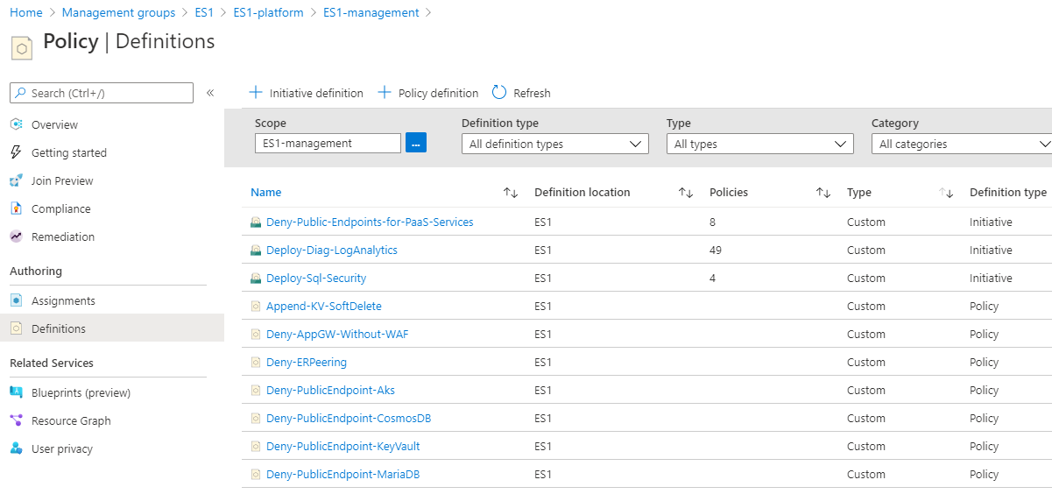
Management
Operational guard rails
Management-as-code
Management on by default
Policies for Management and Monitoring
F1.3
Notes:
Policy Assignment
Policy assignments establish the guard rails that allow for subscription management to be distributed while remaining centrally governed, enabling subscription democratization. Within the context of the Management subscription, the focus of Enterprise-scale is on ensuring the appropriate resources are in place and ready for consumption by platform services and landing zones.
Enterprise-scale policy enforcement includes:
Activity Log for all subscriptions are set to export to Azure Monitor Logs workspace
Resource diagnostic settings for all resources are set to export to Azure Monitor Logs workspace
Azure Monitor for VMs is enabled for all subscriptions
Workbooks provide a comprehensive view into policy actions across the estate.
Design recommendations:
Use Azure Policy for access control and compliance reporting. This provides the ability to enforce organization-wide settings to ensure consistent policy adherence and fast violation detection. For more information, see Understand Azure Policy effects (https://docs.microsoft.com/en-us/azure/governance/policy/concepts/effects)
Use deny policies to supplement Azure AD RBAC assignments. Deny policies are used to prevent deploying and configuring resources that don't match defined standards by preventing the request from being sent to the resource provider. The combination of deny policies and RBAC assignments ensures the appropriate guard rails are in place to enforce who can deploy and configure resources and what resources they can deploy and configure.
Knowledge check:
Which is not an Azure Policy effect:
DeployIfNotExists
Deny
Allow
Audit

Slide 47
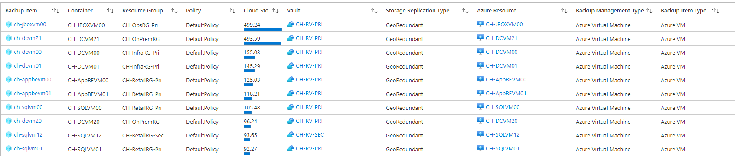
Management
Application VM backup on by default
Policy driven backup schedules
On by default
Policy driven vault deployment
Diagnostics on by default
Workbooks provide holistic view across estate
VM Backup
F1.3
Notes:
Azure Backup removes the need for managing third-party backup software and infrastructure. As with other native features, backup configurations can be set, audited, and enforced with Azure Policy, ensuring that services remain compliant with the organization's requirements.
VM backup should be driven by policy to ensure backups are enabled for all VMs when they are deployed. Enterprise-scale policies will:
Create the recovery services vault, if one does not already exist, in the same RG as the VM
Associate VM to the appropriate vault and enable backup schedule
Ensure vault diagnostic settings are sending logs to platform LA workspace
Workbooks can be used for holistic view of vaults and backups across the Azure estate.
Knowledge check:
Which cannot be backed up by Azure Backup?
Azure VMs
SAP HANA databases in Azure VMs
SQL Server in Azure VMs
Oracle databases in Azure VMs

Slide 48
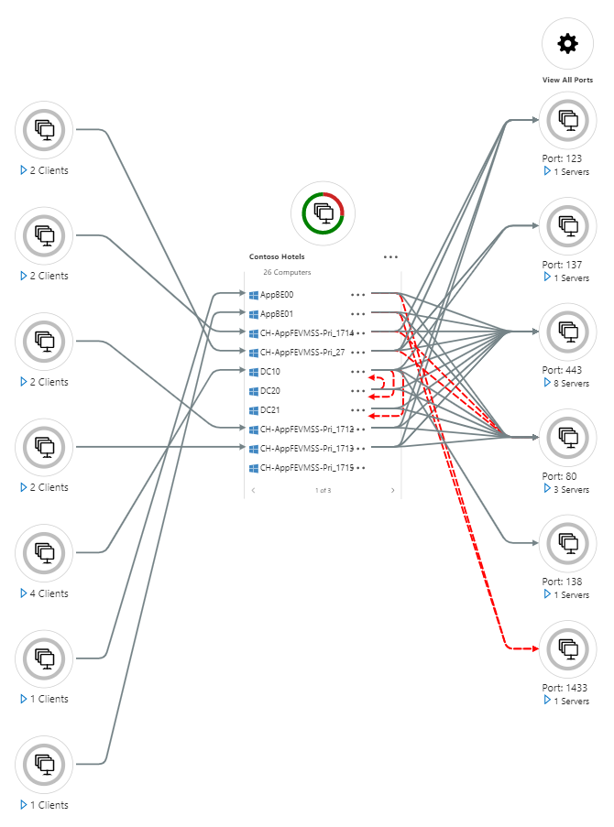
Management
Application VM monitoring on by default
VM Insights
Service Map
Performance Monitoring
Inventory Tracking
Change Tracking
Security Center
Application Monitoring
F2
Notes:
At the platform level, application monitoring is focused on VM and resource health insights that can be turned on by default through policy.
Azure resource diagnostic settings are set via policy to export to centralized Azure Monitor Logs workspace
Azure Monitor Resource Group Insights provide a holistic view of resource health across the Resource Group
Azure Montitor for VMs monitors your virtual machines, virtual machine scale sets, and Azure Arc machines at scale. It analyzes the performance and health of your Windows and Linux VMs, and monitors their processes and dependencies on other resources and external processes.
Instrumenting the application, with tools such as Application Insights, is the responsibility of the application team.
Design recommendations:
Monitor in-guest virtual machine (VM) configuration drift using Azure Policy. Enabling guest configuration audit capabilities through policy helps app team workloads to immediately consume feature capabilities with little effort.
Include service and resource health events as part of the overall platform monitoring solution. Tracking service and resource health from the platform perspective is an important component of resource management in Azure.
Use Azure Monitor metrics for time-sensitive analysis. Metrics in Azure Monitor are stored in a time-series database optimized to analyze time-stamped data. This makes metrics suited for alerts and detecting issues quickly. They can tell you how your system is performing, but they typically need to be combined with logs to identify the root cause of issues.
Use Azure Monitor logs for insights and reporting. Logs contain different types of data that's organized into records with different sets of properties, and they're useful for analyzing complex data from a range of sources such as performance data, events, and traces.
Use Azure Monitor alerts for the generation of operational alerts. Azure Monitor alerts unify alerts for metrics and logs and use features such as action and smart groups for advanced management and remediation purposes.
Knowledge check:
Which is not a destination for resource diagnostic logs?
Azure SQL
Azure storage account
Azure Monitor Logs workspace
Event hub

Slide 49

Management: Business Continuity & Disaster Recovery
Planning for BCDR
Application and data availability requirements:
BCDR for PaaS services and the availability of native DR and HA features
Support for multi-region deployments for failover purposes
Application operations with reduced functionality or degraded performance in the presence of an outage
F3
Notes:
Having a business continuity and disaster recovery plan is essential for organizations as it aids in the time it will take for an organization to resume work in the aftermath of an unforeseen outage or disaster. Organizations are required to define their recovery time objective (RTO) which is the time it takes for an organizations infrastructure to recover and the recovery point objective (RPO) which measures the amount of data loss after the outage or disaster for their application and data availability during the planning phases for their BCDR plan. Application and data availability requirements will differ from organization to organization based on their RTO and RPO requirements. Microsoft Azure's backup service and Azure Site Recovery service both make up the Business Continuity and Disaster Recovery solution in Azure.
This diagram is a holistic review of Enterprise-scale, the section that is relevant to Enterprise scale is what has been highlighted, the backup policy. Backups of an organizations data is a must and critical for the restoration of data.
Backup policies in Enterprise-scale are guardrails that enable and enforce backups.
The backup policy should be configured to align with the organizations recovery point objective (RPO).
Azure backups for PaaS services eliminates the need for 3rd party backup software.
Like traditional backup software, backup policies can be configured, audited, enabled, and enforced with Azure policy to enforce compliance within an organization.
Backup diagnostic data should be collected in a central Log Analytics instance to provide a horizontal view over the backup estate as a whole.
The "Deploy Backup Vault and enforce backup settings for Windows and Linux VMs" policy should be used to deploy the backup vault and enable the backup. The scope for the policy should be the landing zone management group. When used, every resource group with virtual machines in the landing zone subscription will have a backup vault for all virtual machines to backup to.
The "Add diagnostic setting to backup vault" policy should be used to link the backup vault diagnostics to the central log analytics instance. The scope that the policy should be assigned to is the landing zone management group. Doing this creates a horizontal view for all of the virtual machine backups.
When the native backup solution (Azure Backup) can't be used, other options will need to be considered to ensure data consistency and business continuity.
Why are backup policies important? A common issues across organizations when there is no enforcement of backups is that backups aren't configured or configured properly simply by human error. When there is no backup of data and\or resources, there is nothing to restore from. Backup policies eliminates the need to manually configure backups altogether. When the policy is set up, the policy configures the backup automatically.
High Availability
Applications should be deployed using availability zones within the same region
When there is an option to use replication across availability zones for native Azure services, Enterprise-scale recommends it is used. Some examples of this would be Zone redundant storage and Azure SQL DB.
Load balancers or Application Gateways should be used on the backend for stateless virtual machine workloads that are deployed across multiple instances in Availability Zones.
Application-level replication should be used for stateful virtual machine workloads across Availability Zones. An example of this would be SQL AlwaysOn.
Disaster Recovery
Applications and its corresponding data should be asynchronously replicated across multiple paired regions.
Applications architectures should enforce the use of native replication options for stateful virtual machines to replicate data between regions in region pairs. One example is the SQL AlwaysOn.
Azure Site Recovery should be used for applications to replicate stateful IaaS virtual machines that does not support application-level replication.
Externally facing applications that are required to be available always, active/active or active/passive deployment patterns across multiple regions should be utilized. Azure Front Door or Azure Traffic Manager should be used to ensure application availability should one of the regions become unavailable.
Overlapping IP address ranges must be avoided for production and DR sites to prevent connection issues.
When possible, applications should be revamped and modernized to take advantage of Azure PaaS services that provide native replication across region pairs. An example of some services that provide native replication across multiple regions are Cosmo DB, Azure SQL DB, and Azure Key Vault.
Side note: When planning for Azure Pass deployments database backups should be isolated from KeyVault backups in separate storage accounts.

Slide 50

Management: Business Continuity & Disaster Recovery
Planning for BCDR
BCDR for PaaS services and the availability of native DR and HA features.
Support for multi-region deployments for failover purposes
Uses Azure Backup for Virtual Machines
Monitoring and Health Alerting for visibility into the health of resources
Business Continuity and disaster recovery
G3.3
Notes:
Main talking Points
Confidentiality, Integrity, Availability (CIA triad)
Ensuring availability is critical
Azure Backup for VMs
Backups in another region
Encryption of data at rest
Alerting and monitoring for indicators of a failure
Knowledge Check:
What is the process a business will use to continue operation during an unintended outage?
Application Availability
Business Continuity & Disaster Recovery
Availability
Logging & Alerting

Slide 51
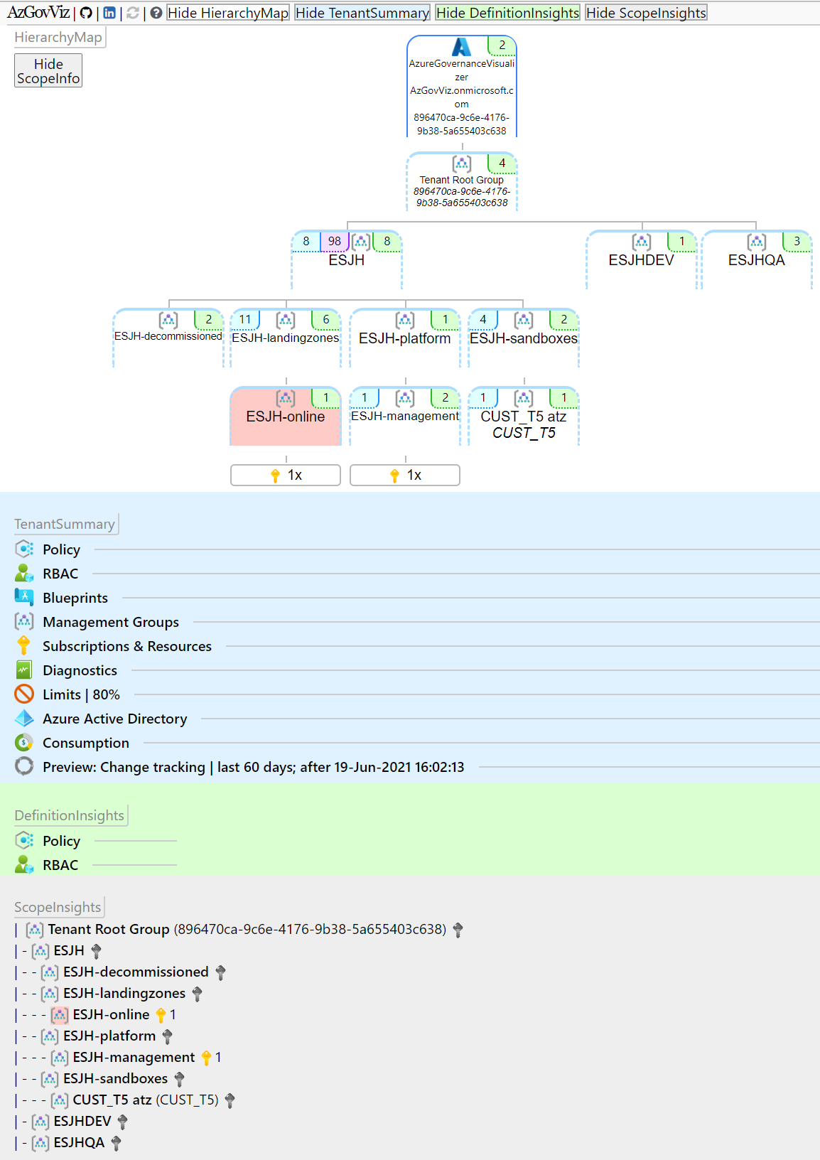
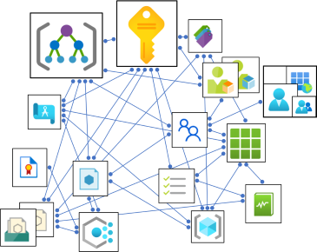
Azure Governance Visualizer aka AzGovViz
AzGovViz is intended to help you to get a holistic overview on your technical Azure Governance implementation by connecting the dots.
The script is PowerShell based, it collects Azure Governance related information such as Azure Policy, RBAC (a lot more) by polling Azure ARM and Microsoft Graph APIs.
From the collected date the following outputs will be generated:
HTML Connects the dots by providing insights on HierarchyMap, TenantSummary, DefinitionInsights and ScopeInsights on Management Groups and Subscriptions
JSON Export of Management Group Hierarchy including all MG/Sub Policy/RBAC definitions, Policy/RBAC assignments and some more relevant information
CSV Enriched collected data available in CSV file
MD Azure DevOps Wiki ‘Mermaid plugin‘ ready markdown file

Slide 52
Security
Subscription and scale limits as they apply to Key Vault
Key Vault serves a security boundary since access permissions for keys, secrets and certificates are at the vault level
Premium SKU can be leveraged where HSM protected keys are required
Key rotation and secret expiration
Use a federated Key Vault model to avoid transaction scale limits
Establish an automated process for key and certificate rotation
Define Encryption & Key Management
G1
Notes:
TALK TRACK:
ES is secure by design leveraging
Azure DepolyIfNotExist Policies
Centralized Identity & Access Mgmt with PIM, MFA, Conditional Access to provide the components for Zero-Trust
Protect secrets with a strategic Key Vault approach
All logs go to a centralized Log Analytics Workspace
Azure Security Center for
Key Message: Key Vaults are for applications
Emphasis on central management with policies to ensure compliance and to not reach scale limits.
Key Vault should be centrally managed, but not centrally deployed.
Key Vault should not be in a dedicated subscription as a shared service.
Key Vault, by design, should be distributed across the applications that need it.
Identity & Access
Leverage PIM for roles assignments to avoid permanent access.
Use of custom roles to add granularity to the permissions
Consider discussing MSFT vs Customer managed keys

Slide 53
Security
Secure by design
Identity and access management (AAD, RBAC, MFA, PIM)
Centralized management with Management Group Hierarchy
Secure Network Design (NSG, Firewall, WAF, DDoS)
Encryption / Key Management (SSE with MMK/CMK, Key Vault - Access Policies)
Centralized monitoring and auditing with Log Analytics, Azure Security Center, Sentinel
Azure DeployIfNotExist Policy to control configuration management
Business Continuity (Azure Backup, Multi-region, HA)
Service Enablement Framework
Define Encryption & Key Management
G1.1
Notes:
Main talking Points
ES is secure by design:
Centralized Identity & Access Mgmt
Management Group hierarchy (https://docs.microsoft.com/en-us/azure/cloud-adoption-framework/ready/enterprise-scale/enterprise-enrollment-and-azure-ad-tenants)
Network security https://docs.microsoft.com/en-us/azure/cloud-adoption-framework/ready/enterprise-scale/network-topology-and-connectivity
Protect secrets and encryption (https://docs.microsoft.com/en-us/azure/cloud-adoption-framework/ready/enterprise-scale/security-governance-and-compliance)
Centralized Logging (https://docs.microsoft.com/en-us/azure/cloud-adoption-framework/ready/enterprise-scale/management-and-monitoring)
Azure Policies (https://docs.microsoft.com/en-us/azure/cloud-adoption-framework/ready/enterprise-scale/security-governance-and-compliance)
Continuous visibility and Compliance (https://docs.microsoft.com/en-us/azure/cloud-adoption-framework/ready/enterprise-scale/security-governance-and-compliance)
Business Continuity (https://docs.microsoft.com/en-us/azure/cloud-adoption-framework/ready/enterprise-scale/business-continuity-and-disaster-recovery)
Service Enablement (https://docs.microsoft.com/en-us/azure/cloud-adoption-framework

Slide 54
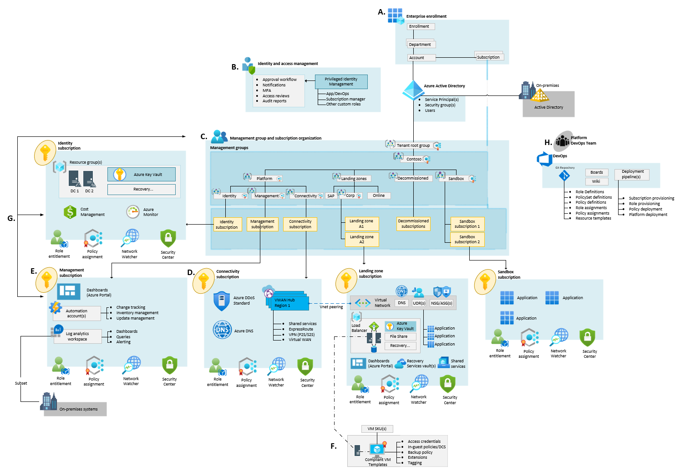
Security
Encryption and Key Management
Define Encryption and Key Management
Subscription and scale limits as they apply to Key Vault
Key Vault serves as a security boundary since access permissions for keys, secrets and certificates are at the vault level
Premium SKU can be leveraged where HSM-protected keys are required
Key rotation and secret expiration
Use a federated Key Vault model to avoid transaction scale limits
Establish an automated process for key and certificate rotation
G1.2 – G1.3
Notes:
Main talking Points
Key Message: Key Vaults are for applications
Emphasis on central management with policies to ensure compliance and to not reach scale limits.
Key Vault should be centrally managed, but not centrally deployed.
Key Vault should not be in a dedicated subscription as a shared service.
Key Vault, by design, should be distributed across the applications that need it.
Knowledge Check:
How do you protect secret for an application?
BLOB Encryption
Store them in GitHub
Write them on a sticky notes
Azure Key Vault

Slide 55
Security
Consider the following design elements:
Privileged Identity Management
Multi-Factor Authentication
Conditional Access
Role Based Access Control
Auditing and Logging
Managed Identities for Azure resources
Identity and Access Management
G2.3
Notes:
Main talking Points
Centralized Identity & Access Mgmt
AAD and RBAC Roles
PIM
MFA
Conditional Access to provide the components for Zero-Trust
Knowledge Check:
What is a way to grant access to an Administrators to make changes in Azure for a certain time period?
Network Security Groups
Multi-factor Authentication
Privilege Identity Management
Global Administrator Access
/cloud-adoption-framework

Slide 56
Security
Management Group and Subscription Organization
Azure Management Groups provide a way to efficiently manage access, policies, and compliance across an enterprise through a hierarchy made up of management groups and subscriptions.
G2.4
Notes:
Main talking Points
Use Management Group structure within an AAD tenant to support org mapping
Must be appropriately considered when planning Azure adoption at-scale
Group Subscriptions to apply policy
Apply RBAC Roles
Knowledge Check:
What is the best way to group Azure Subscriptions?
Group Policy
Azure Policy
Role Based Access Controls
Management Groups

Slide 57
Security
Azure Policy ‘guard rails’
Managing platform policy assignments
Federated Model
Built-in policies
Re-use of policy definitions at inherited scopes
Azure Policy
G2.5 – G2.6
Notes:
Main talking Points
Azure Policy provide guardrails for services
DeployIfNotExist Process
Use built-in
Policy inheritance
Use Security Center for contiguous compliance and improvement of Security Score
Knowledge Check:
What type of Azure Policy will deploy changes if it detect they are missing from a resource?
DeployIfNotExist
RegularPolicy
AuditPolicy
SecurityCenterPolicy

Slide 58
Security
Network Segmentation
Network Encryption
Secure Network Design
G2.6
Notes:
Main talking Points
Planning for Landing Zone Network Segmentation explores key recommendations to deliver highly secure internal network segmentation within a "Landing Zone" to drive a network Zero Trust implementation.
The Zero Trust model assumes a breached state and verifies each request as though it originates from an uncontrolled network.
An advanced Zero Trust network implementation employs fully distributed ingress/egress cloud micro-perimeters and deeper micro-segmentation.
Network Security Groups can use Azure Service Tags to facilitate connectivity to Azure PaaS services.
Use NSGs and ASGs to microsegment traffic within the "Landing Zone" and avoid using a central NVA to filter these traffic flows.
It is recommended to enable NSG Flow Logs and feed them into Traffic Analytics to gain insights into internal and external traffic flows.
For VWAN-based network topologies, route traffic across "Landing Zones" via Azure Firewall only if the customer requires filtering and logging capabilities for traffic flowing across "Landing Zones".
Tip: NSGs can be used to implement zero trust principles but keep in mind they don’t inspect traffic (I.E. if the NSG is allow 443 and a bad actor tunnels ssh through 443, the nsg will allow it where a NGFW would block it).
Network Encryption explores key recommendations to achieve network encryption between on-premises and Azure as well as across Azure regions.
Cost and available bandwidth are inversely proportional to length of encryption tunnel between endpoints.
When using VPN to connect to Azure, traffic is encrypted over the internet via IPsec tunnels.
When using ExpressRoute with Private Peering, traffic is not currently encrypted.
MACsec encryption can be applied to ExpressRoute Direct to achieve network encryption.
Azure does not currently offer native encryption over Global VNet Peering.
Tip: Ipsec can also be used on individual VMs to encrypt traffic. Also, many customers falsely assume every bit of traffic in any public cloud is encrypted by default (like storage is).
Traffic Inspection - In many industries customers require that traffic in Azure, particularly inbound and outbound internet traffic, is mirrored to a network packet collector for deep inspection and analysis. This section therefore explores key considerations and recommended approaches for mirroring or tapping traffic within Azure Virtual Networks.
Azure Virtual Network TAP (VTAP) is in preview, but your must reach to azurevnettap@microsoft.com for availability details.
Network Watcher packet captures in Network Watcher is GA, but captures are limited to a maximum period of 5 hours.
Use Network Watcher packet capture despite the limited capture window.
Evaluate if NSG Flow Logs v2 provide the level of detail required.
Use 3rd party solutions for scenarios where sustained deep packet inspection is required.
Do not develop a custom solution to mirror traffic. While this might be acceptable for small scale scenarios, this approach is not encouraged at scale due to complexity and supportability issues which may arise.
Tip: Any enterprise with a requirement for ‘deep packet inspection’ is going to use a 3rd party NVA until azfw supports it (NDA roadmap).
Knowledge Check:
How do you restrict traffic in a Vnet?
Network Security Group
Group Policy
Network Virtual Application
Tiering the App

Slide 59
Security
Consider the following design elements:
Log Analytics Workspace Design
Auditing and log retention
Dashboards and Visualizations
Logs and Metrics
VM Management
Monitoring and Alerting
Security Monitoring
Management & Monitoring
G3.2
Notes:
Main talking Points
Role Entitlement
Role entitlement refers to the implementation of fine-grained RBAC controls, with appropriate access at the appropriate scope, in conjunction with PIM and aligned with the operating model. Within the context of the Management subscription, the focus of Enterprise-scale is on providing central IT with visibility across the platform to ensure the enterprise Azure estate can be operationally maintained. Areas of visibility include audit logs, patch status, and security alerts.
Policy Assignment
Policy assignments establish the guard rails that allow for subscription management to be distributed while remaining centrally governed, enabling subscription democratization. Within the context of the Management subscription, the focus of Enterprise-scale is on ensuring the appropriate resources are in place and ready for consumption by platform services and landing zones.
Network Watcher
Azure Network Watcher provides tools to monitor, diagnose, view metrics, and enable or disable logs for resources in an Azure virtual network. Network Watcher is designed to monitor and repair the network health of IaaS (Infrastructure-as-a-Service) products which includes Virtual Machines, Virtual Networks, Application Gateways, Load balancers, etc.
Security Center
Azure Security Center also plays an important part in your monitoring strategy. It can help you monitor the security of your machines, networks, storage, data services, and applications. Security Center provides advanced threat detection by using machine learning and behavioral analytics to help identify active threats targeting your Azure resources. It also provides threat protection that blocks malware or other unwanted code and reduces the surface area exposed to brute force and other network attacks.
When Security Center identifies a threat, it triggers a security alert with steps you need to take to respond to an attack. It also provides a report with information about the threat that was detected.
Knowledge Check:
Where can you check the current Security posture of a Virtual Machine?
Azure Monitor
Log Analytics
VM Scale Sets
Azure Security Center

Slide 60
Security
Mapping
Design
Implementation
Evidence
Azure Fabric
(Compliance and Certifications)
Azure Foundations
(Built-in, Deployed, Enabled)
Platform as a Service
Infrastructure as a Service
Containers
Serverless
Compliant VM
Service Enablement Framework
G4.1 – G4.2
Notes:
Talk through the process of getting a service ready
Examples:
What controls do you need for monitoring
How will you know if there is a vulnerability
What settings will go in Azure Policy
Who will get notifications
Knowledge Check
What is the process of getting services ready to safely use in Azure?
Service Fabric
Allowed Services
Service Enablement Framework
Compliance Framework

Slide 61

Platform Automation & DevOps
Planning for a DevOps Approach
Where central teams are concerned, CI/CD pipelines should be used to manage policy definitions, role-definitions, policy assignments, and template galleries
The blanket application of a DevOps model will not miraculously establish capable DevOps teams.
Establish a cross functional DevOps Platform Team to build, manage and maintain your Enterprise Scale architecture.
H1
Notes:
Key Message: In Azure, everything is a resource. Management of the resources provisioning should be repeatable, consistent and versioned
Description : The image highlights the functional roles and responsibilities of a Platform DevOps Team.
Resources & Policies are deployed through ARM and centrally stored in the GIT repository seen on the left.
The right side is the automated provisioning, deployment, orchestration and lifecycles of the subscription, roles and policies.
Both together will enable teams to deploy and manage infrastructure through automation
Delineation between DevOps vs AppOps
DevOps – Application team is responsible for managing the full lifecycle of the resources created
AppOps – Some customers don't have not adopted devops and have a dedicated, centralized team to support IT operations on their behalf (E.G Backup, Tuning, Provisioning)
Identify and Access Management
DevOps/App Ops group with Contributor role assigned at RSG level

Slide 62
Azure Landing Zone – Resources
Customer
Start with Cloud Adoption Framework Enterprise-Scale Landing Zone
Overview Enterprise-scale Executive Briefing
Azure landing zone Architecture and Design Guideline (GitHub)
Azure landing zone Reference Implementation
Azure landing zone interactive guide

